Slide 1

The
Immutable Application Security
Platform
for the Modern Enterprise
Copyright © 2024 Waratek | All Rights Reserved | Confidential
Notes:
Immutable - unchanging over time or unable to be changed. Highlight the fact that in the world we live in with change taking place rapidly and AI, Attacks, Job Changes etc
“Nice to have 1 Immutable Application Security Platform Vendor”

Slide 2
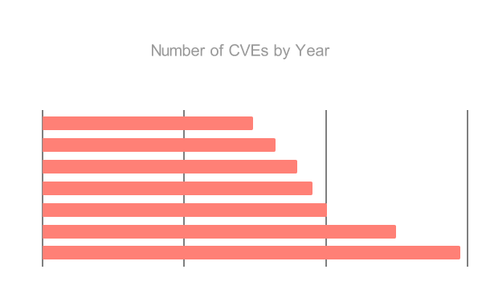

2024 Concerning State of AppSec
30k
CVEs published to NVD - 18,000+ not analyzed, as of Oct 2024
56%
CVEs weaponized not analyzed
82%
with POC not Analyzed
Notes:
This data shows a substantially growing backlog of CVEs that are not being promptly analyzed and rated for severity by NIST’s National Vulnerability Database.
Furthermore, this is exasperated by NIST’s 12% budget cut this year.
The CVE data directly quantifies the challenge security teams face in staying on otp of new vulnerabilities and provides a concrete example how of the number of unaddressed vulnerabilities is rapidly piling up - showing a need for a compensating control.

Slide 3
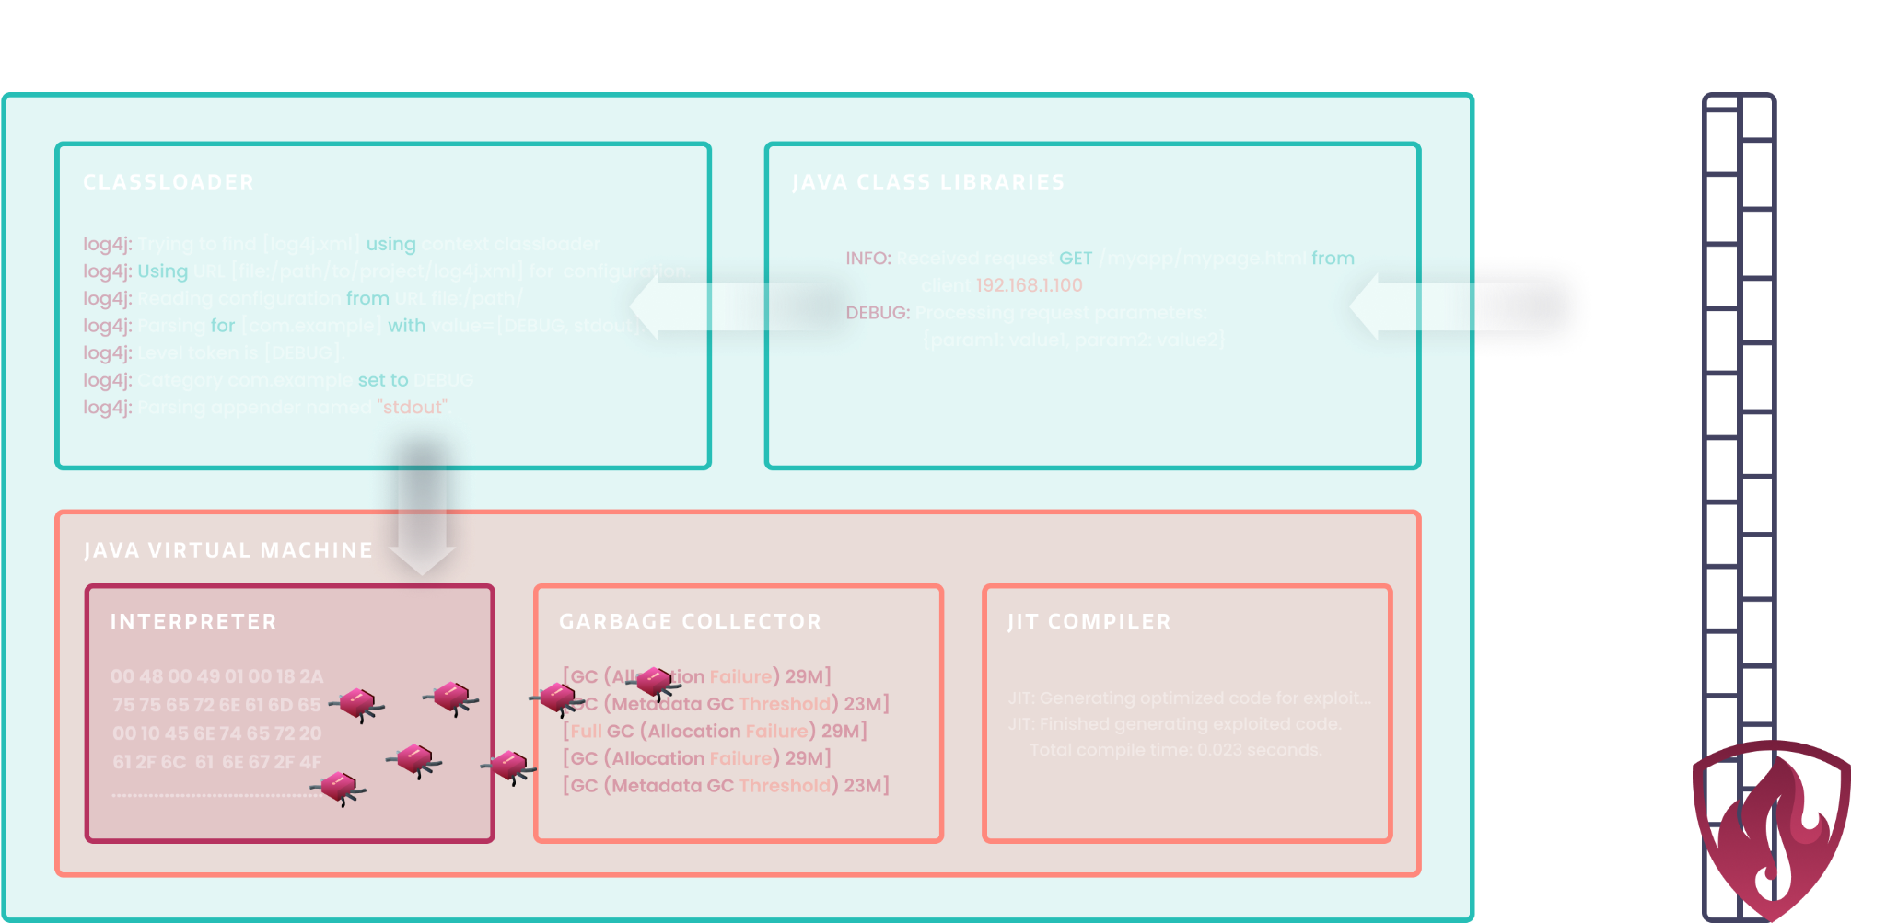
The Secret Sauce
Copyright © 2023 Waratek | All Rights Reserved | Confidential
Notes:
When a malicious request passes through a WAF, there’s traditionally been nothing you can do to stop bad things from happening at the application layer.
Waratek follows the incoming data as it interacts with the application in a process called “tainting.” At this point we would simply mark this incoming data as untrusted.
Using syntactic lexical analysis Waratek breaks down and analyzes the code at a granular level which allows us to detect malicious inputs as they interact with the application logic
So, whenever the untrusted data from the network attempts to do something bad, whether this is one minute or one year later, we’re able to block the attack from the running application.
In essence Waratek is providing a secure execution pathway for vulnerable code
**************************************************************************************************************************************************************************************************************************
It sounds complicated, but the steps it takes are simple:
1. First the taint engine maintains a ledger of the previous and current state of the incoming data
2. Before allowing the data to flow to the next step, the output is validated to ensure things like SQL injections aren’t going to take place
3. When the data shows that an active exploit is taking place, the data is rolled back a step, the function that will lead to an exploit is rebuilt to remove the vulnerability, and the data is allowed to pass through it again, but this time safely
Waratek employs advanced semantic syntactic and lexical analysis techniques to analyze application behaviors in real time.
Unlike statistical anomaly detection, which relies on pattern frequency or sequence, semantic syntactic and lexical analysis focuses on the structure and syntax of data inputs and their usage within the application.
By breaking down and analyzing the code at a granular level, Waratek can detect malicious inputs as they interact with the application logic.
For instance, lexical analysis allows Waratek to examine the specific syntax of inputs to identify when untrusted data has been manipulated to exploit vulnerabilities, such as concatenated SQL queries or HTML and Javascript code that result to XSS attacks.
This method goes beyond pattern matching by analyzing the intent and structure of the input, providing real-time, precise identification of security threats. Waratek’s lexical analysis engine ensures comprehensive detection of both known and unknown threats, offering a more sophisticated layer of runtime protection compared to statistical analysis.

Slide 4
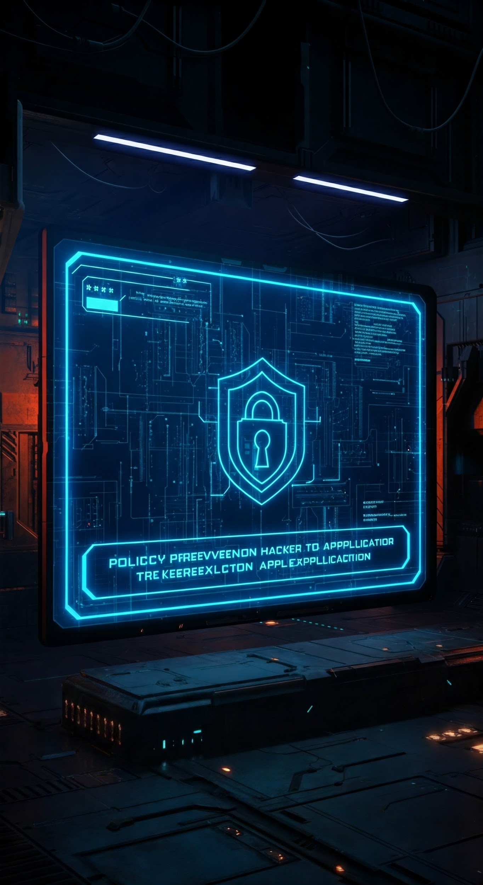
Policy Based Security
Autonomously addresses CWEs and CVEs in live executing code with no developer effort, no source code changes and no application downtime.
Benefits of defining security policies:
Immutable security
Consistency across configurations & applications
Elimination of human error
Autonomy for security teams
Instant time-to-protection
Automated security for all applications
Copyright © 2025 Waratek | All Rights Reserved | Confidential

Slide 5
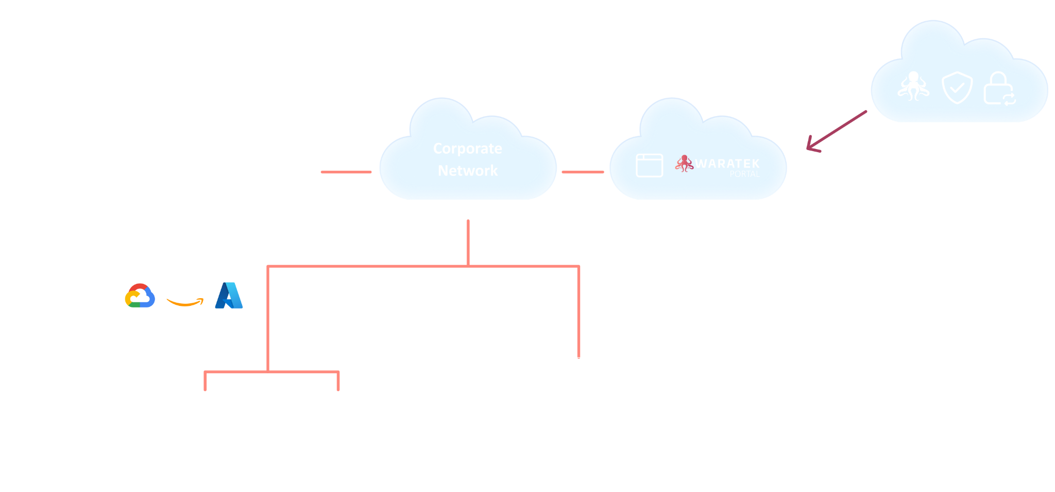


SOAR/XDR/SIEM
Copyright © 2025 Waratek | All Rights Reserved | Confidential

Slide 6

We See Everything
File system operation
Network connection
Call to an API
Execution of an OS command
Connection to a database
SQL statement
Memory read and write operation
CPU instruction
Copyright © 2025 Waratek | All Rights Reserved | Confidential
Notes:
I mentioned at the beginning how our founders were focused on compilers and quickly discovered that they can really help secure applications… this is why. At the just in time compiler, we can see everything. Any of these actions in this list are captured and that’s why we say the only security closer to your applications are your developers.

Slide 7
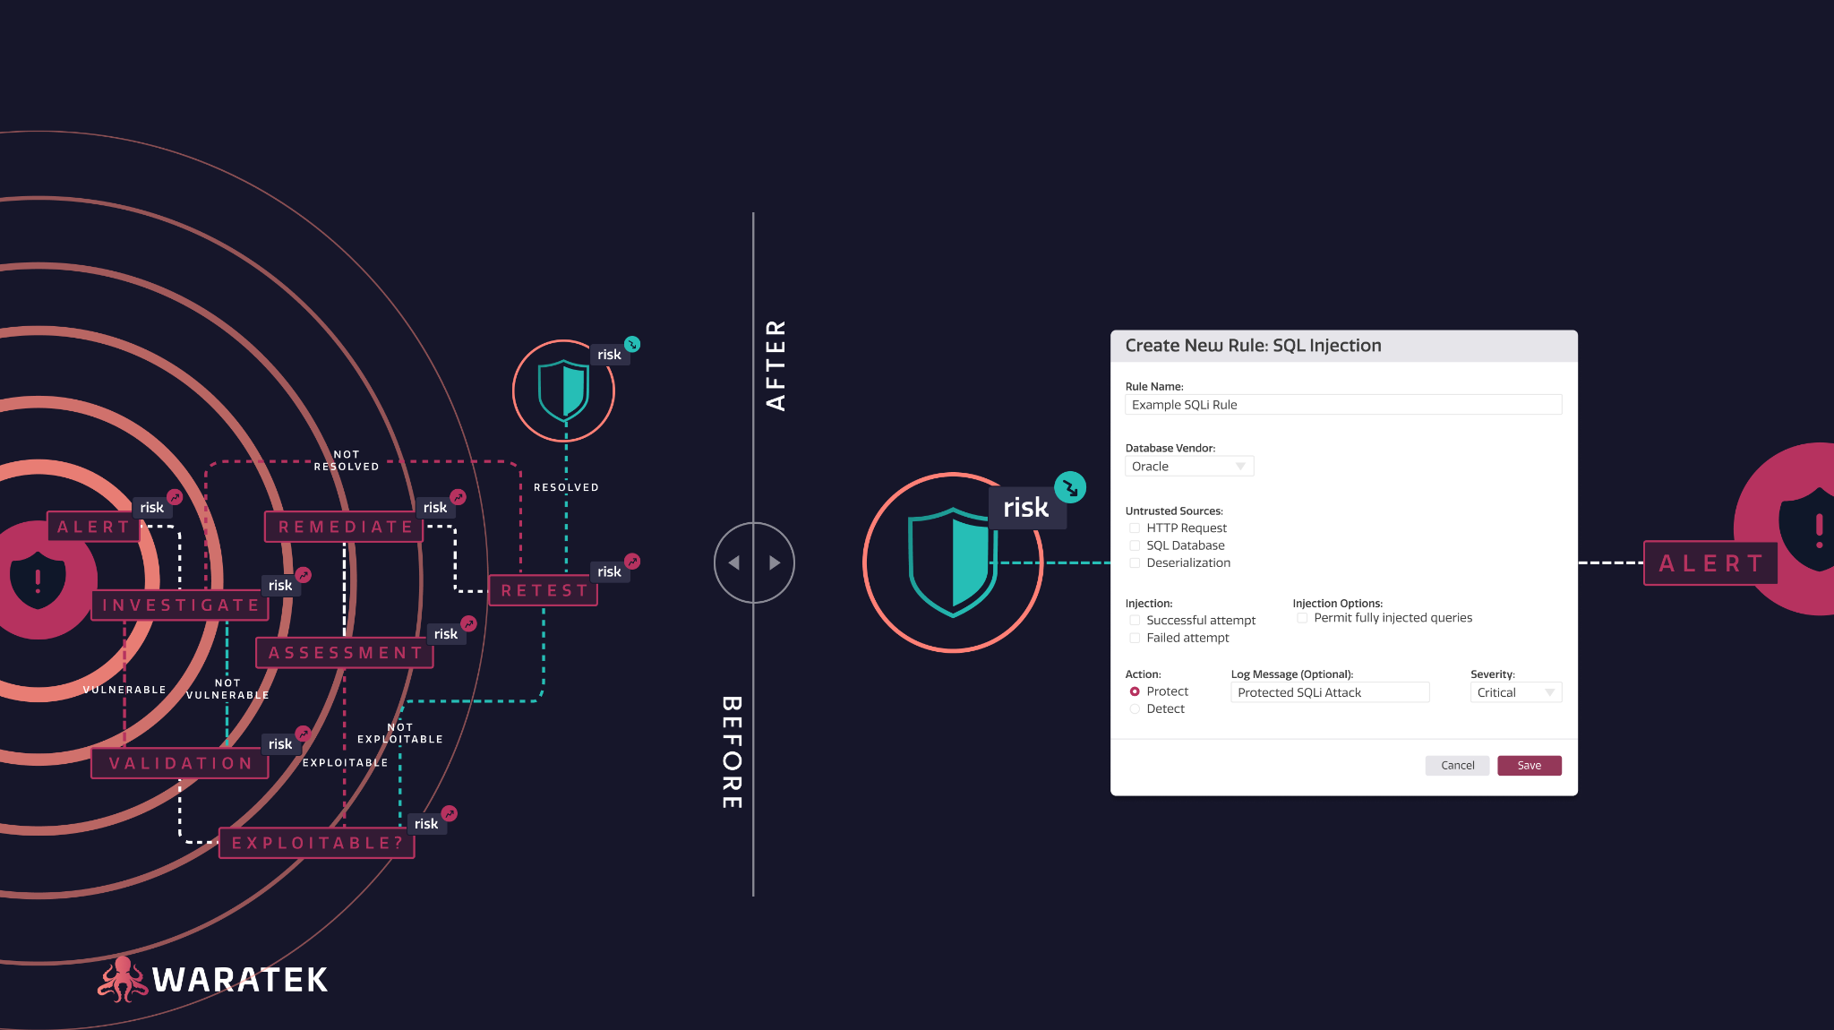
Instant Risk Remediation
Copyright © 2024 Waratek | All Rights Reserved | Confidential
Notes:
So that all sounds good, but what does it mean?
It means before Waratek if you needed to prevent insecure deserialization that you needed to add authorization to each field in each endpoint across every app.
To do so, you would need to manually check for any possible type of input that could deliver a dangerous payload, such as text, password, image, video, and file fields.
You’d then need to match any possible type of serialization that’s possible. That means pattern matching for RCE, SQL, Denial of Service, you name it.
And you might be able to pull that off fairly well.
But that 1 form that was created 5 years ago that no one thought to add authorization to?
Well, bad actors won’t forget about it.
Now fast forward to life with Waratek.
You don’t have to authorize every field for every endpoint.
All you need to do is create one rule to protect against RCE and every point of entry for a bad actor, including the form that everyone forgot about, will be protected instantly.
If they ask about latency or performance overhead:
Average performance overhead

Slide 8
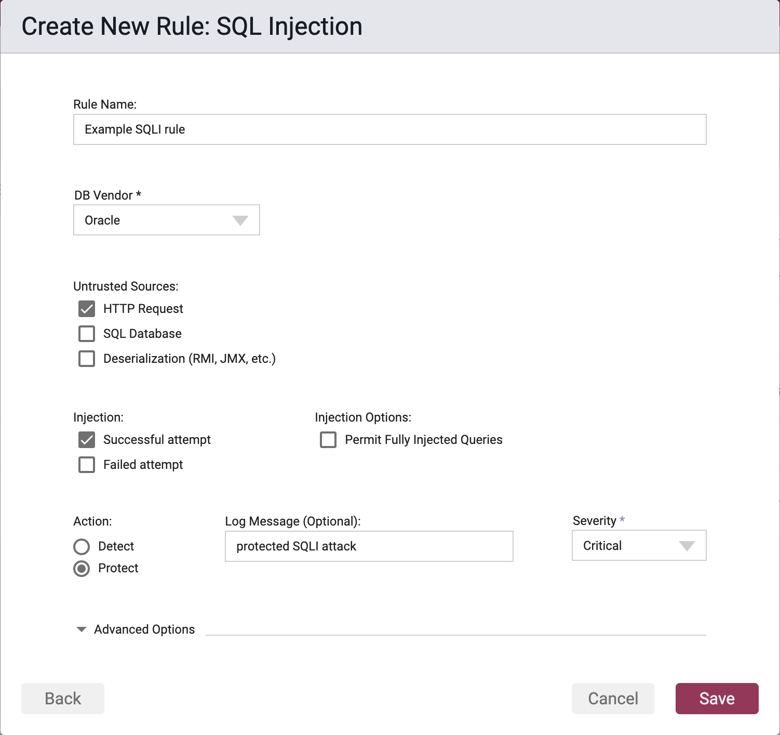
Declarative Rules
No heuristics or tuning
Negligible false positives
Immutability
Notes:
The first is… our Declarative set of rules.
Waratek makes it extremely simple for you to say, “I want to mitigate this risk - in this case sql injection - from happening across any of my applications.”
You can set a policy with a few clicks.
Our patented technology continuously analyses the code, so that you don’t have to worry about the code today, tomorrow, or 15 versions from now.
Hence, the policy is immutable.
Next let’s look at…
[If prospect questions how this is achieved]
This is achieved by tracing how the data flows through the application, which shows us where and when untrusted data from the network is used by vulnerable code.
[if they want an example]
Let's assume your example application allows users to upload a profile picture and display it on their profile page. When a user uploads a profile picture, there's several steps that happen:
1. The user uploads a file through the `/upload` endpoint.
2. The `allowed_file` function checks if the file has an allowed extension.
3. If the file has an allowed extension, the `upload_file` function saves the file to the server's upload folder.
4. The user's profile record is updated in the database and the new URL is served the next time the profile is visited
Waratek is able to track the flow of the data through each step, keeping a ledger of the changes that happen. Then no matter if we're 3 weeks down the road, and another function transforms the data again, we have the ability to see when and where the data becomes vulnerable and correct before it's moved further through the application.

Slide 9
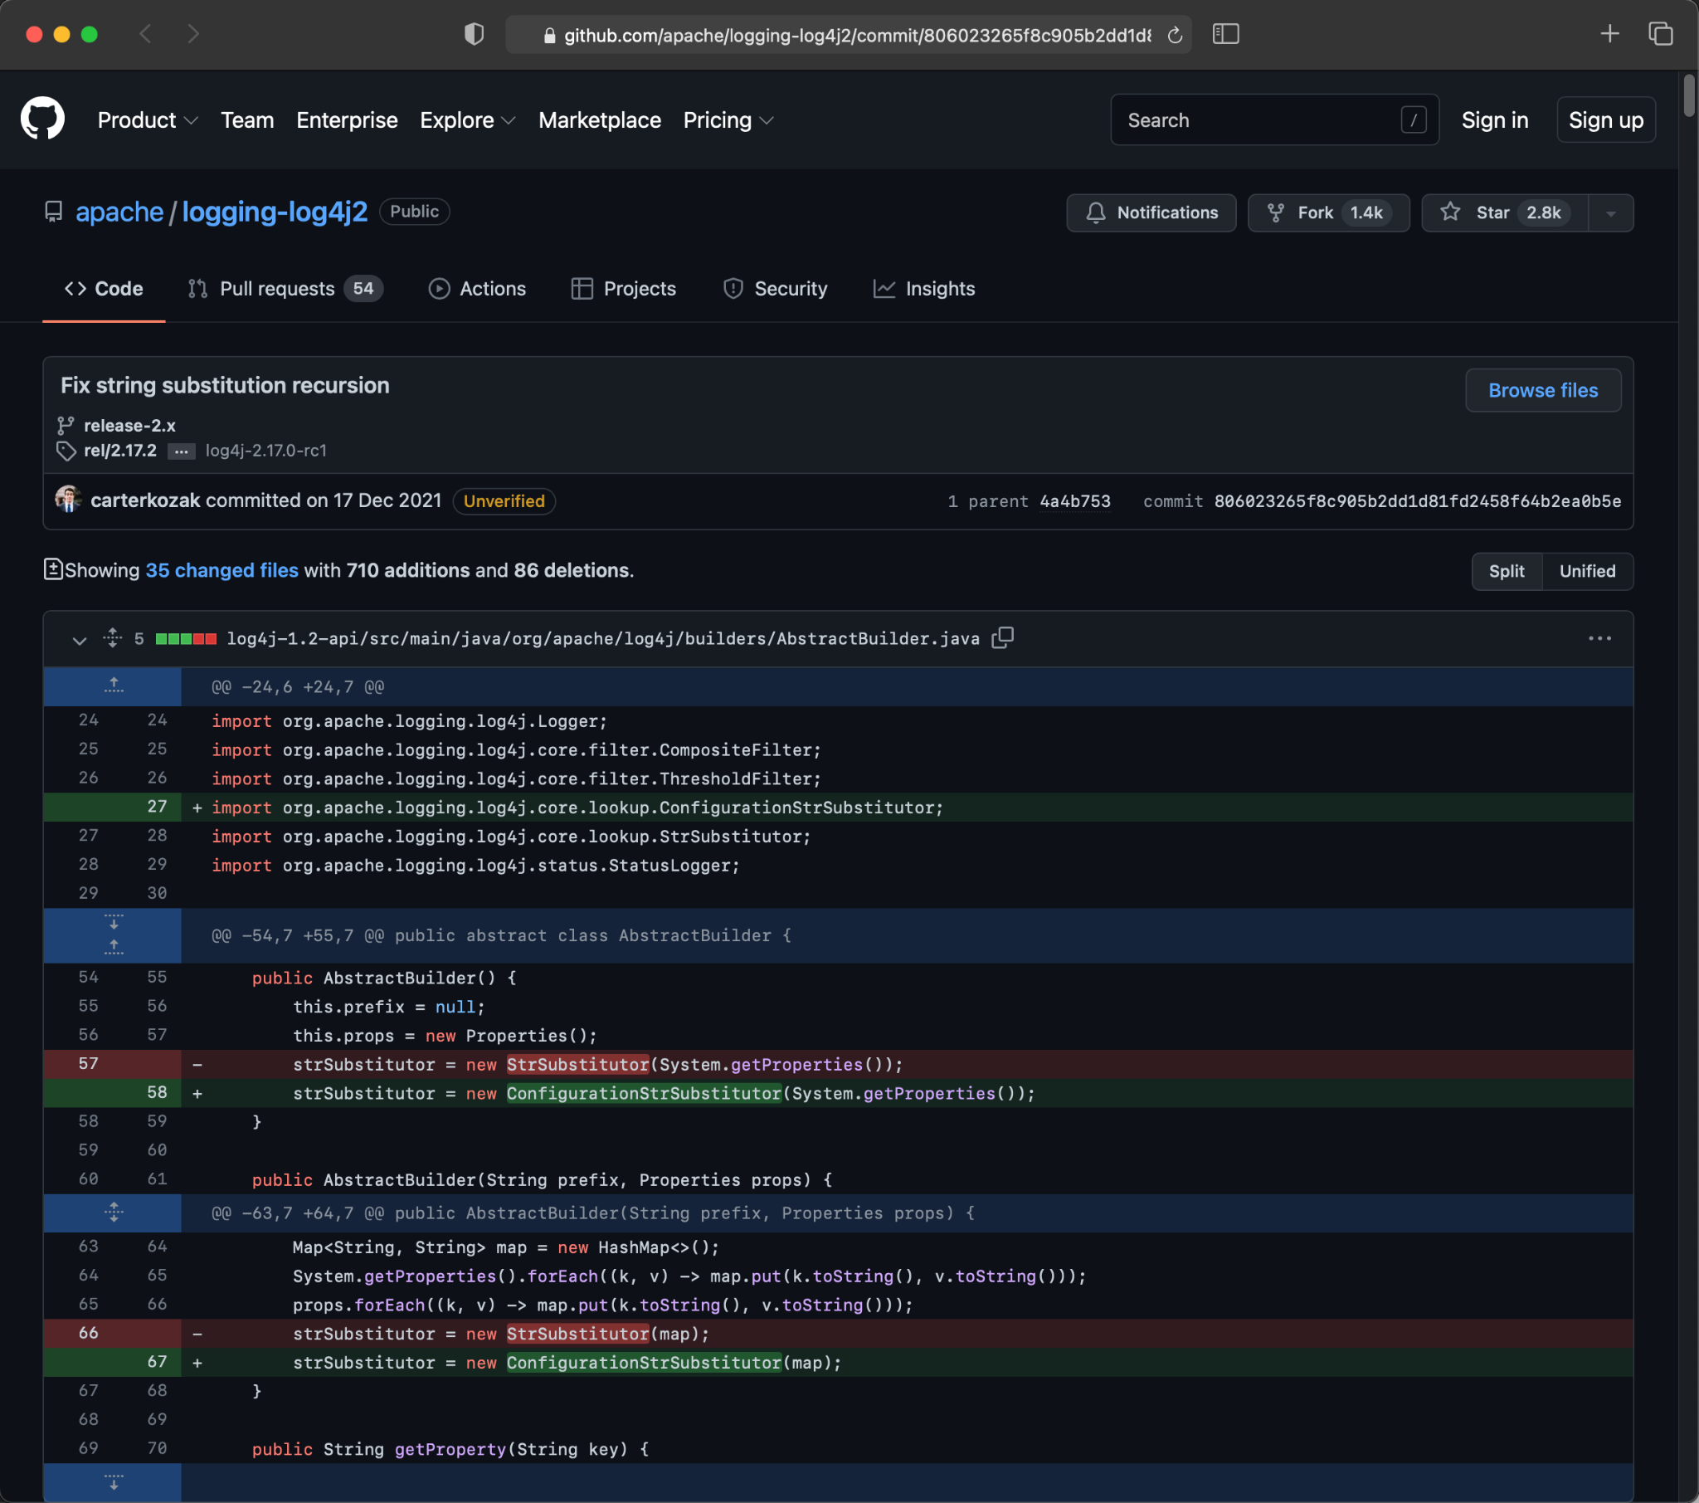
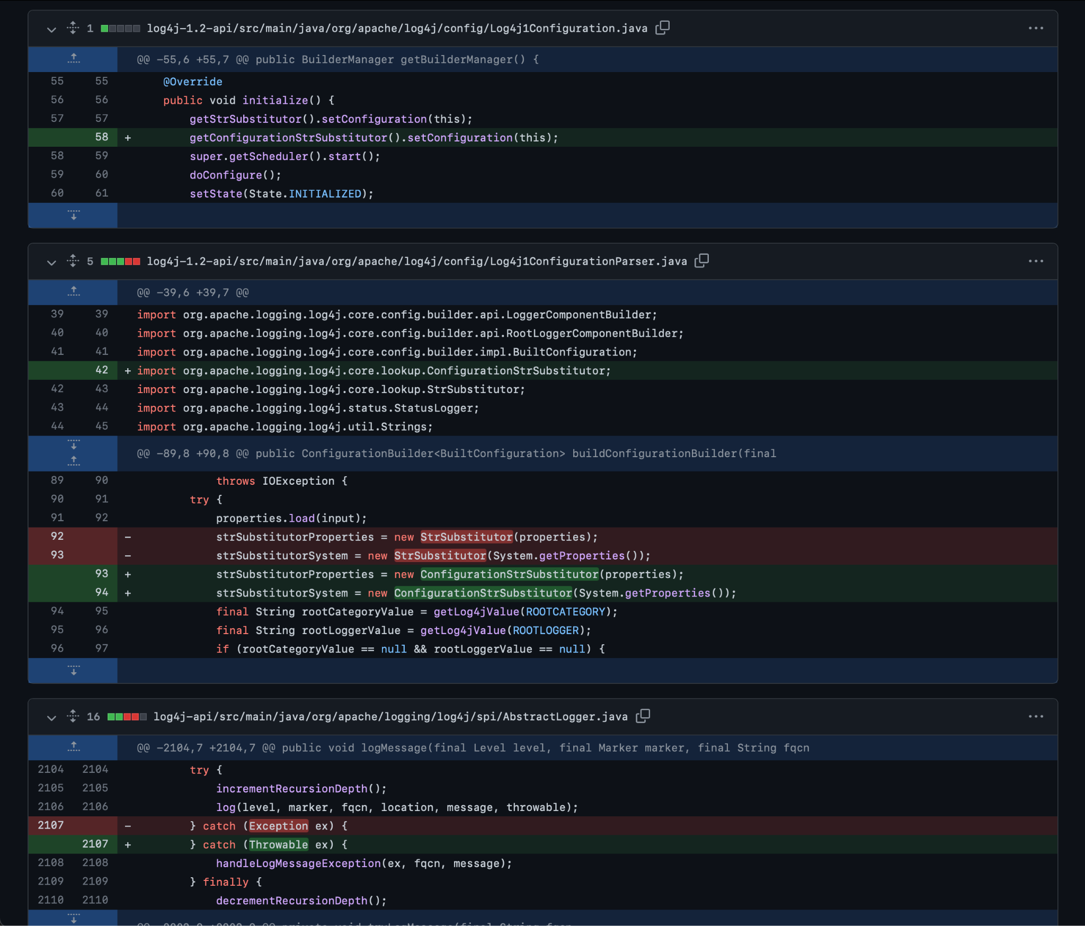
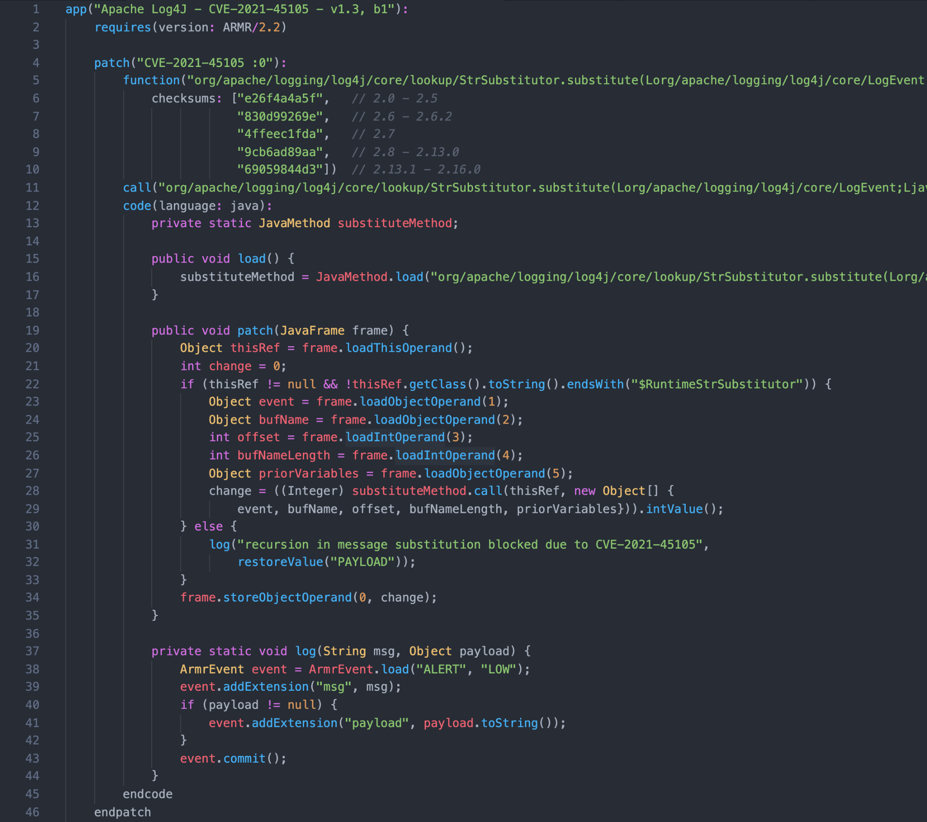
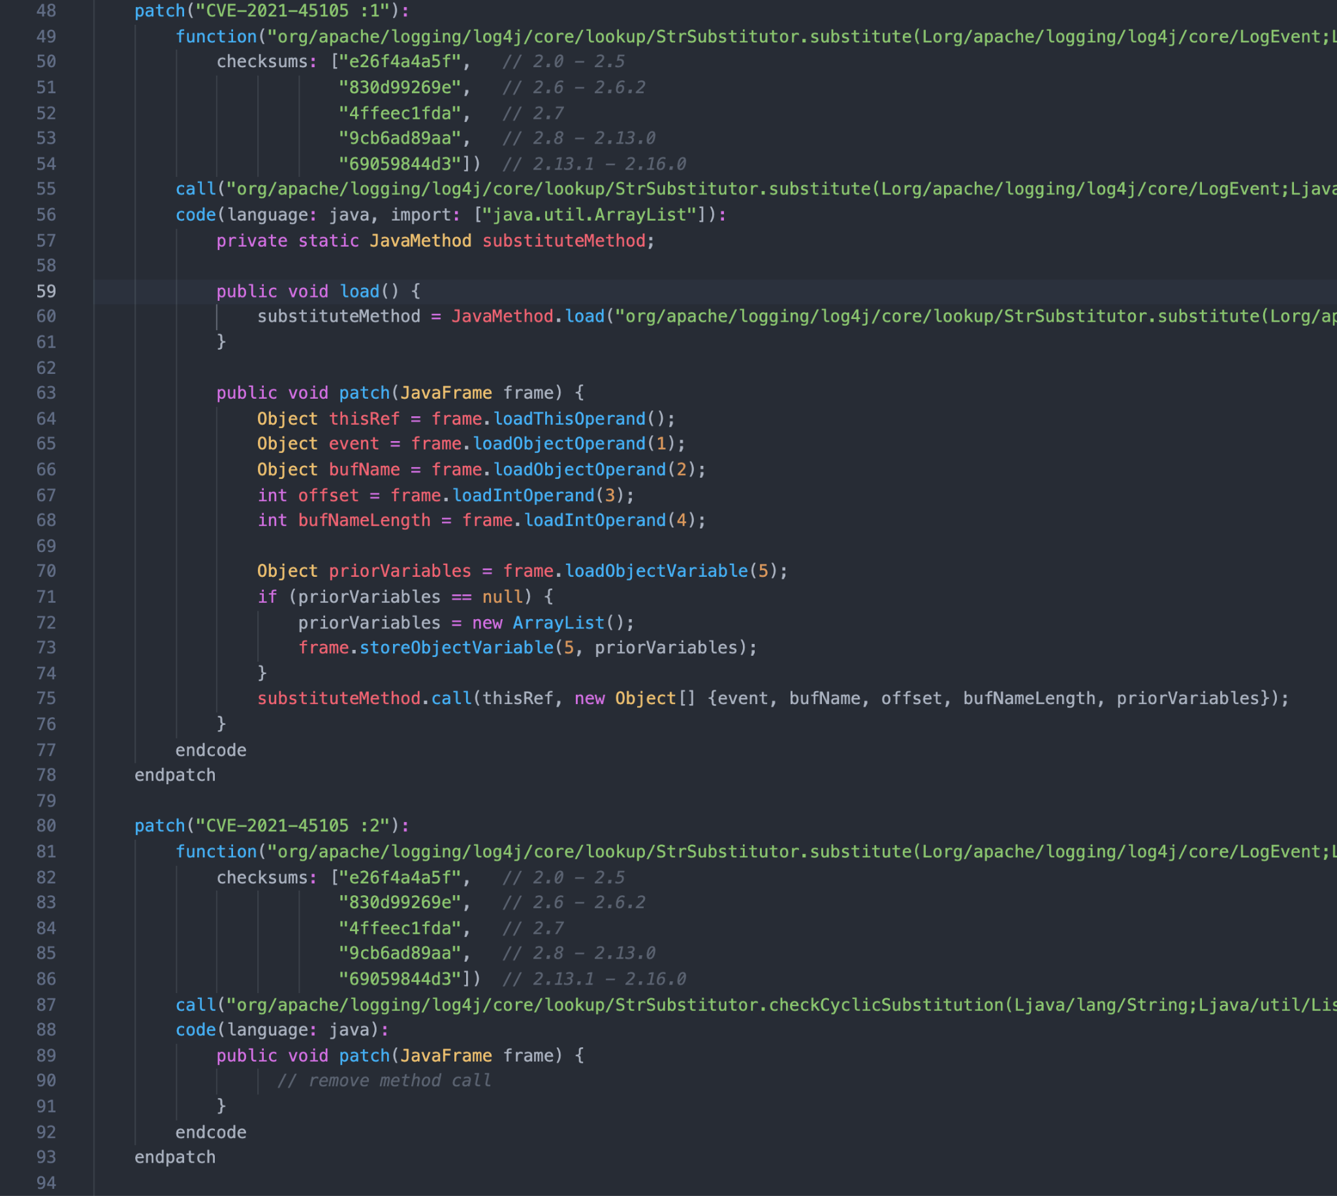
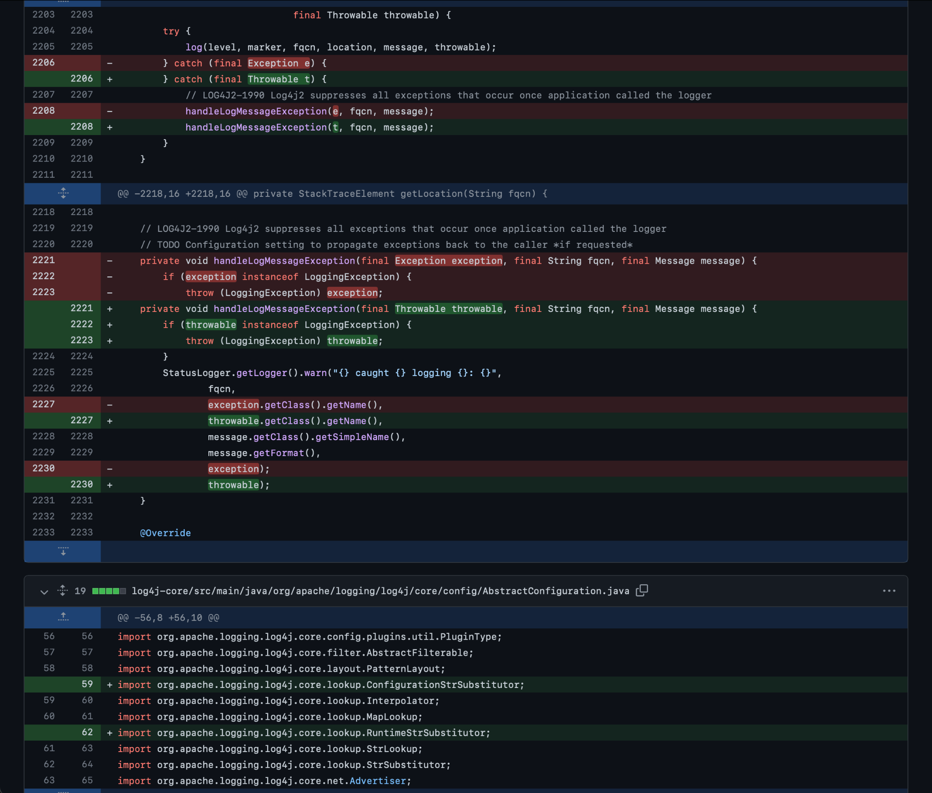
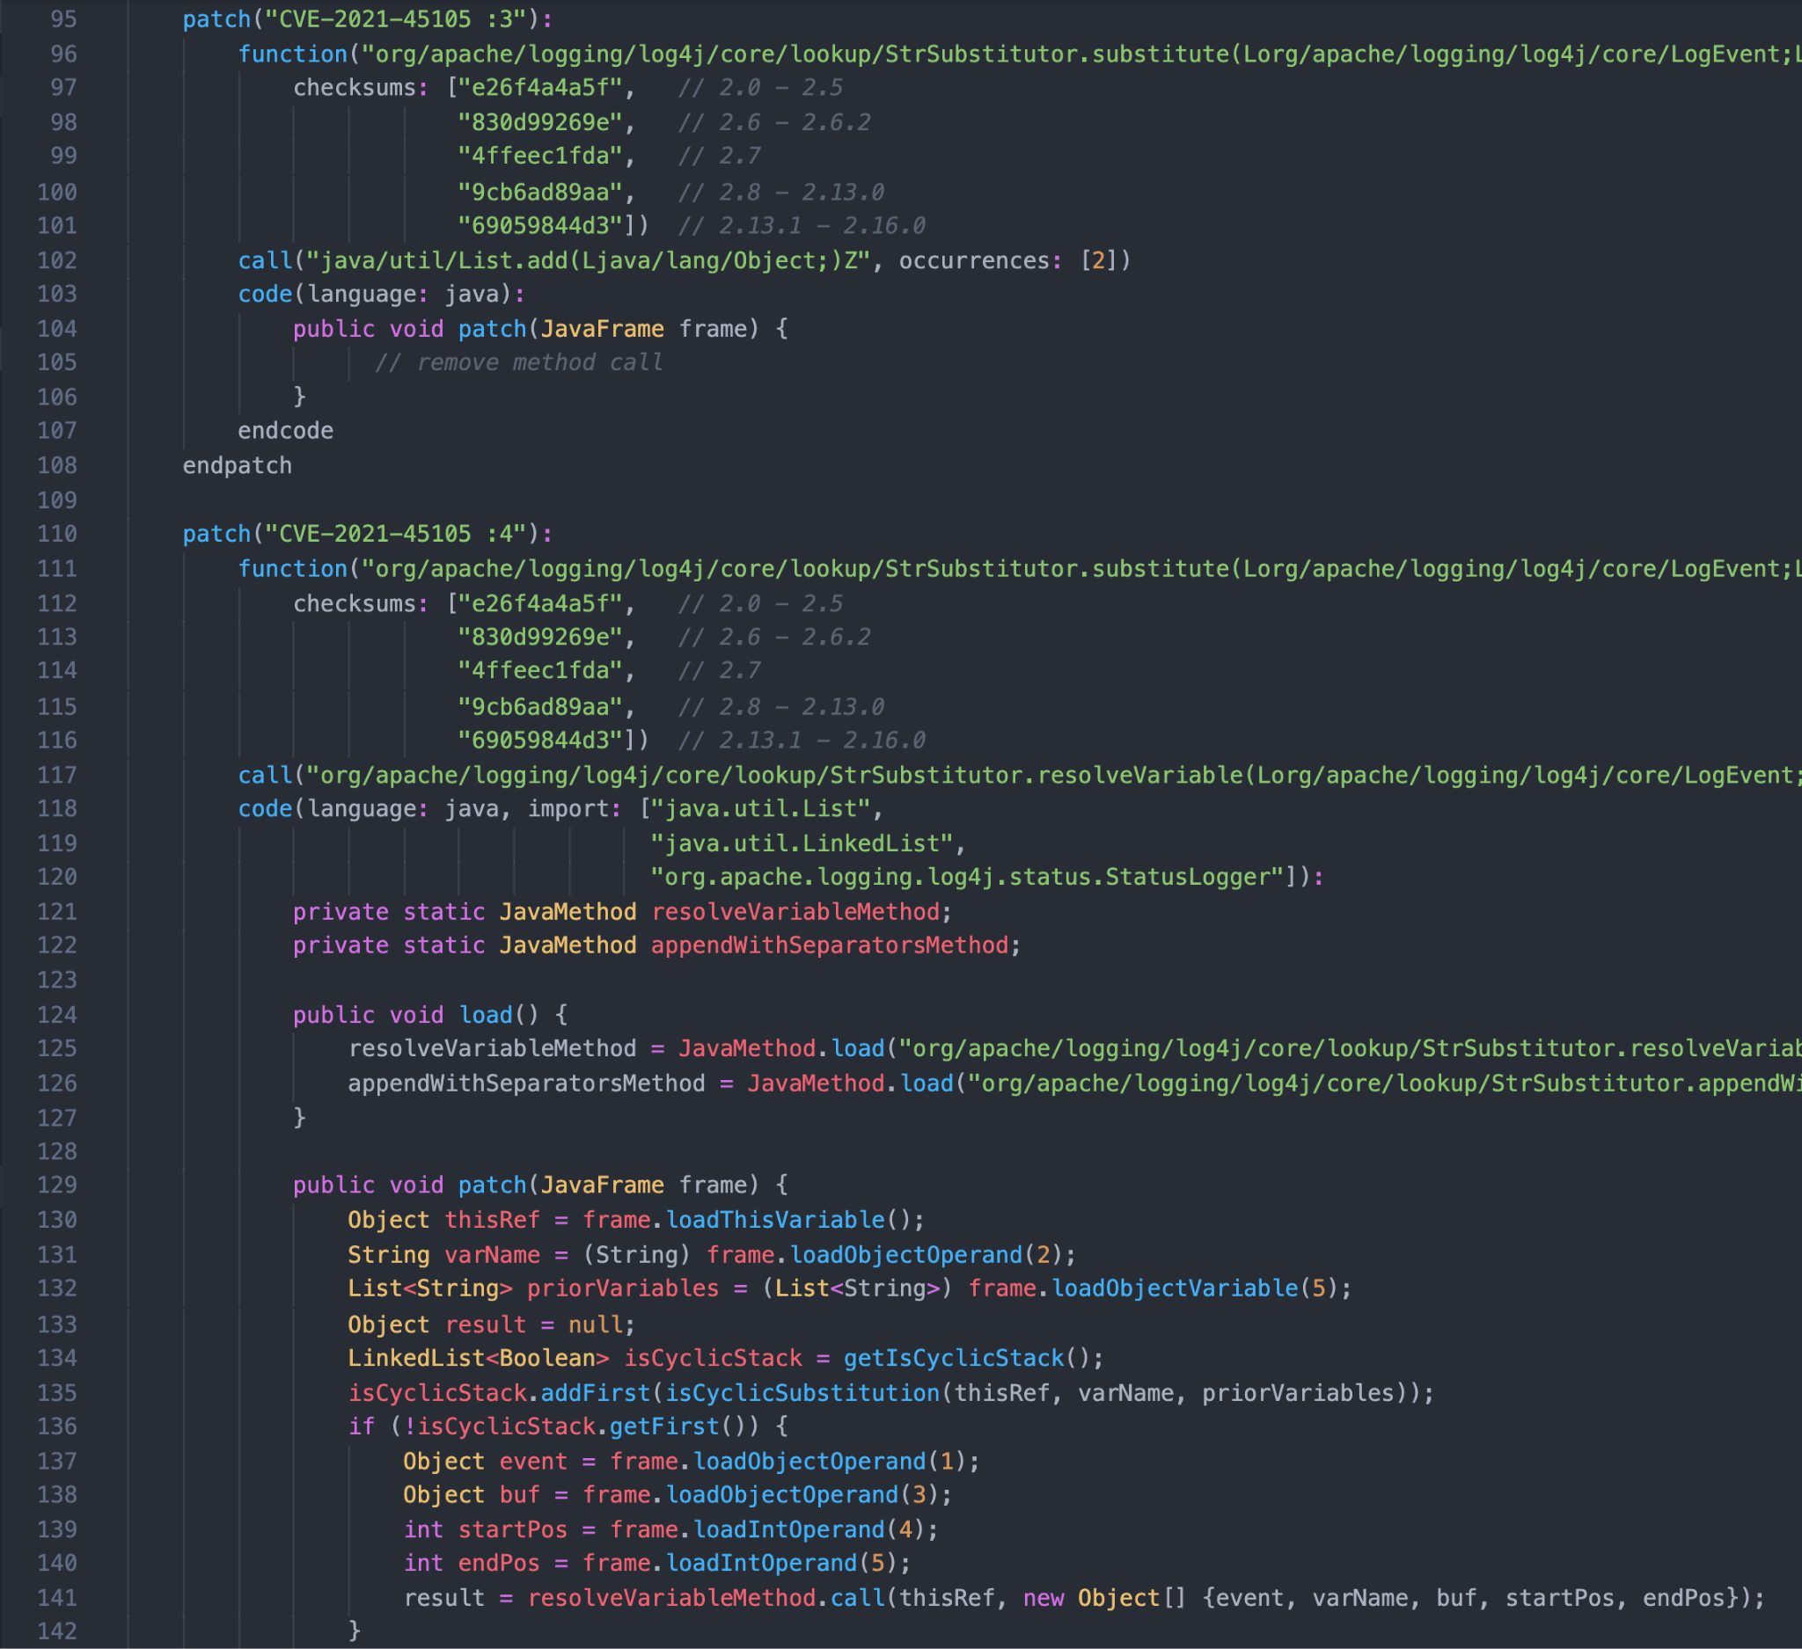
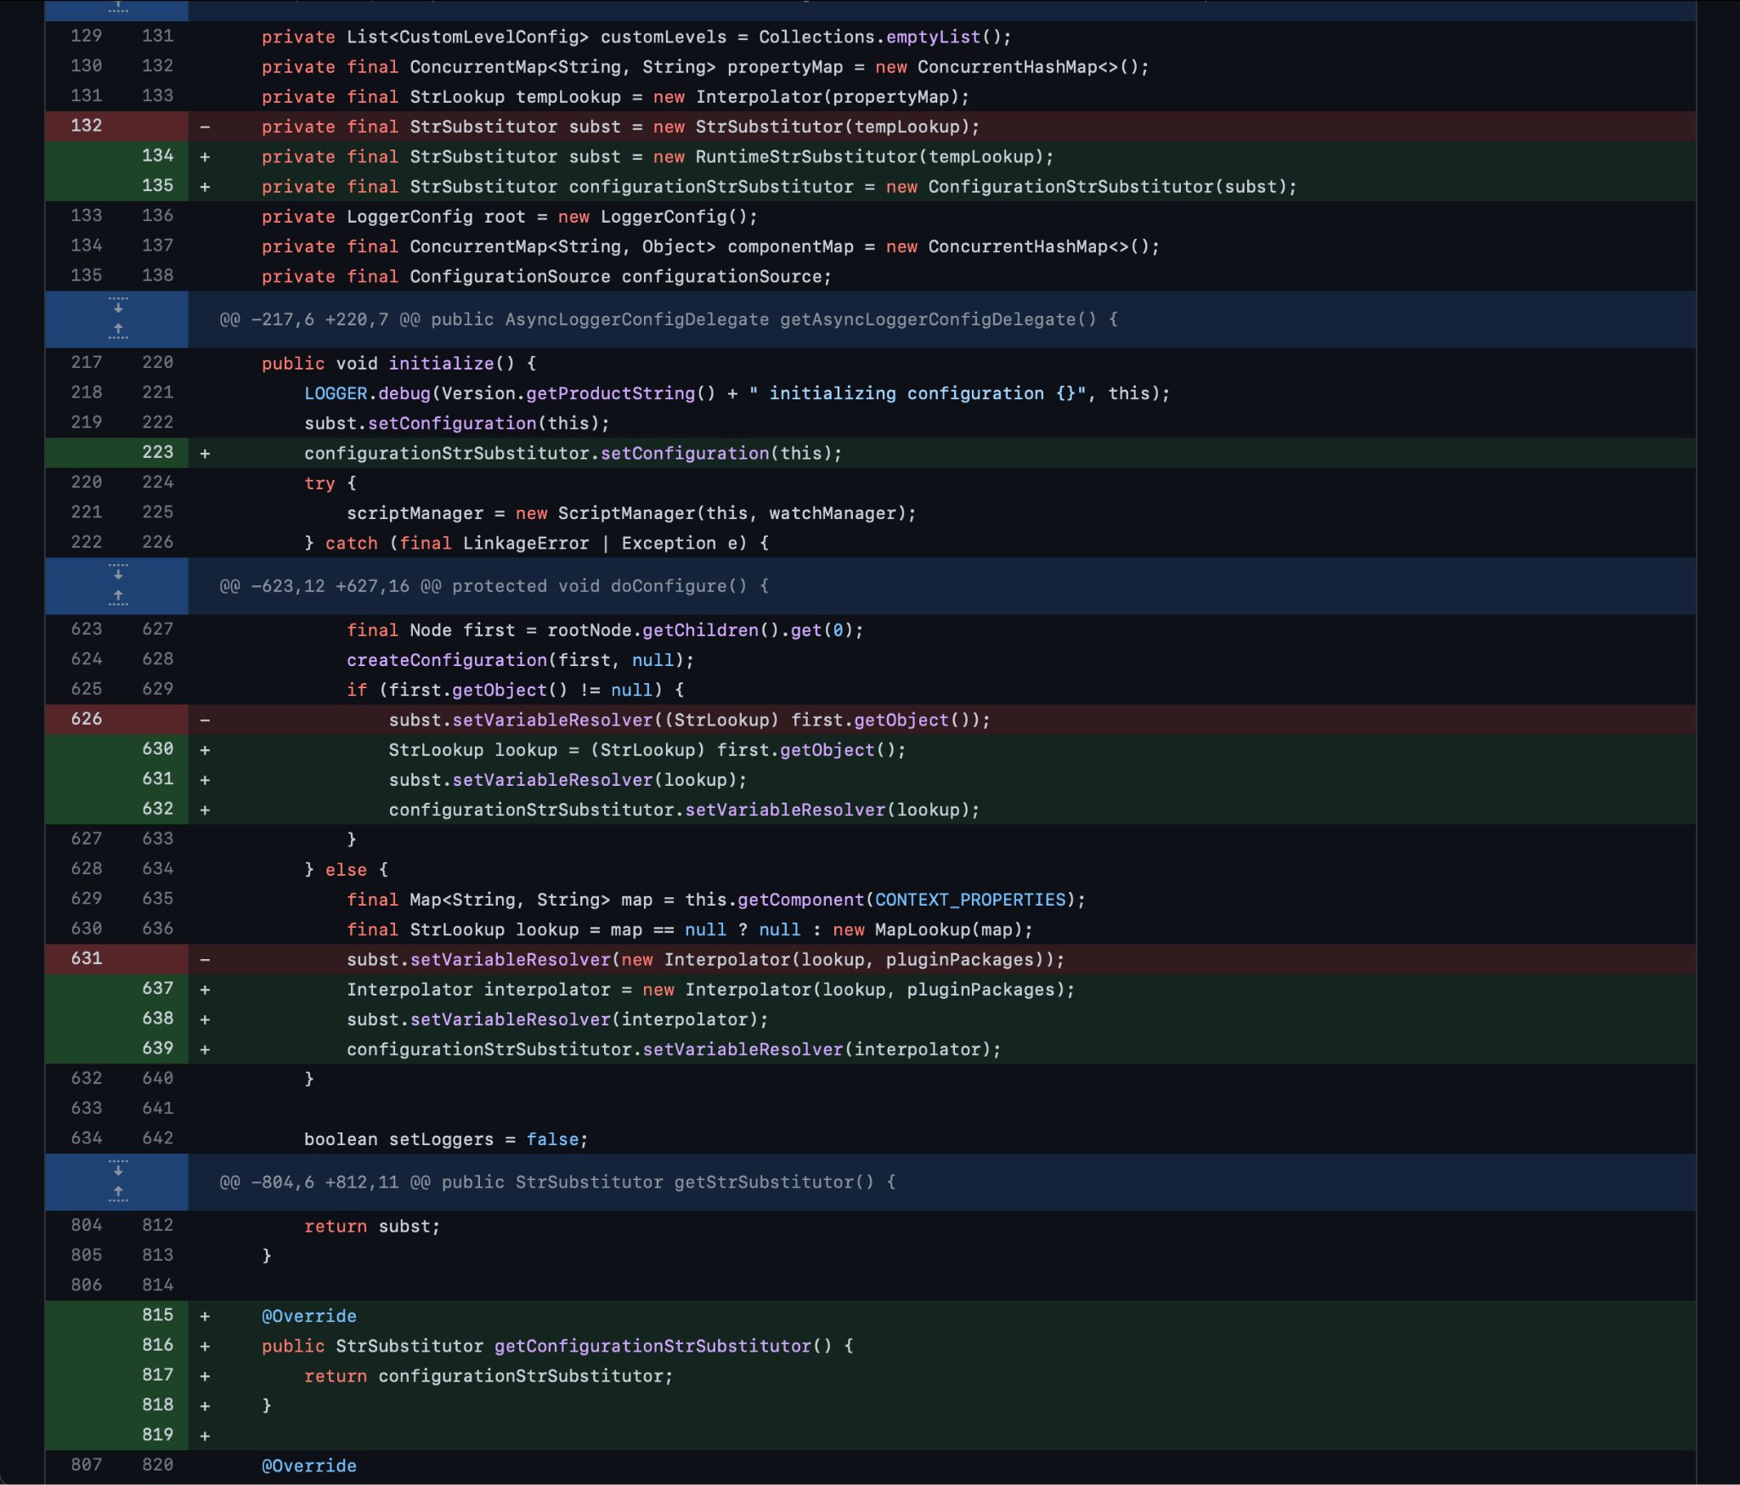
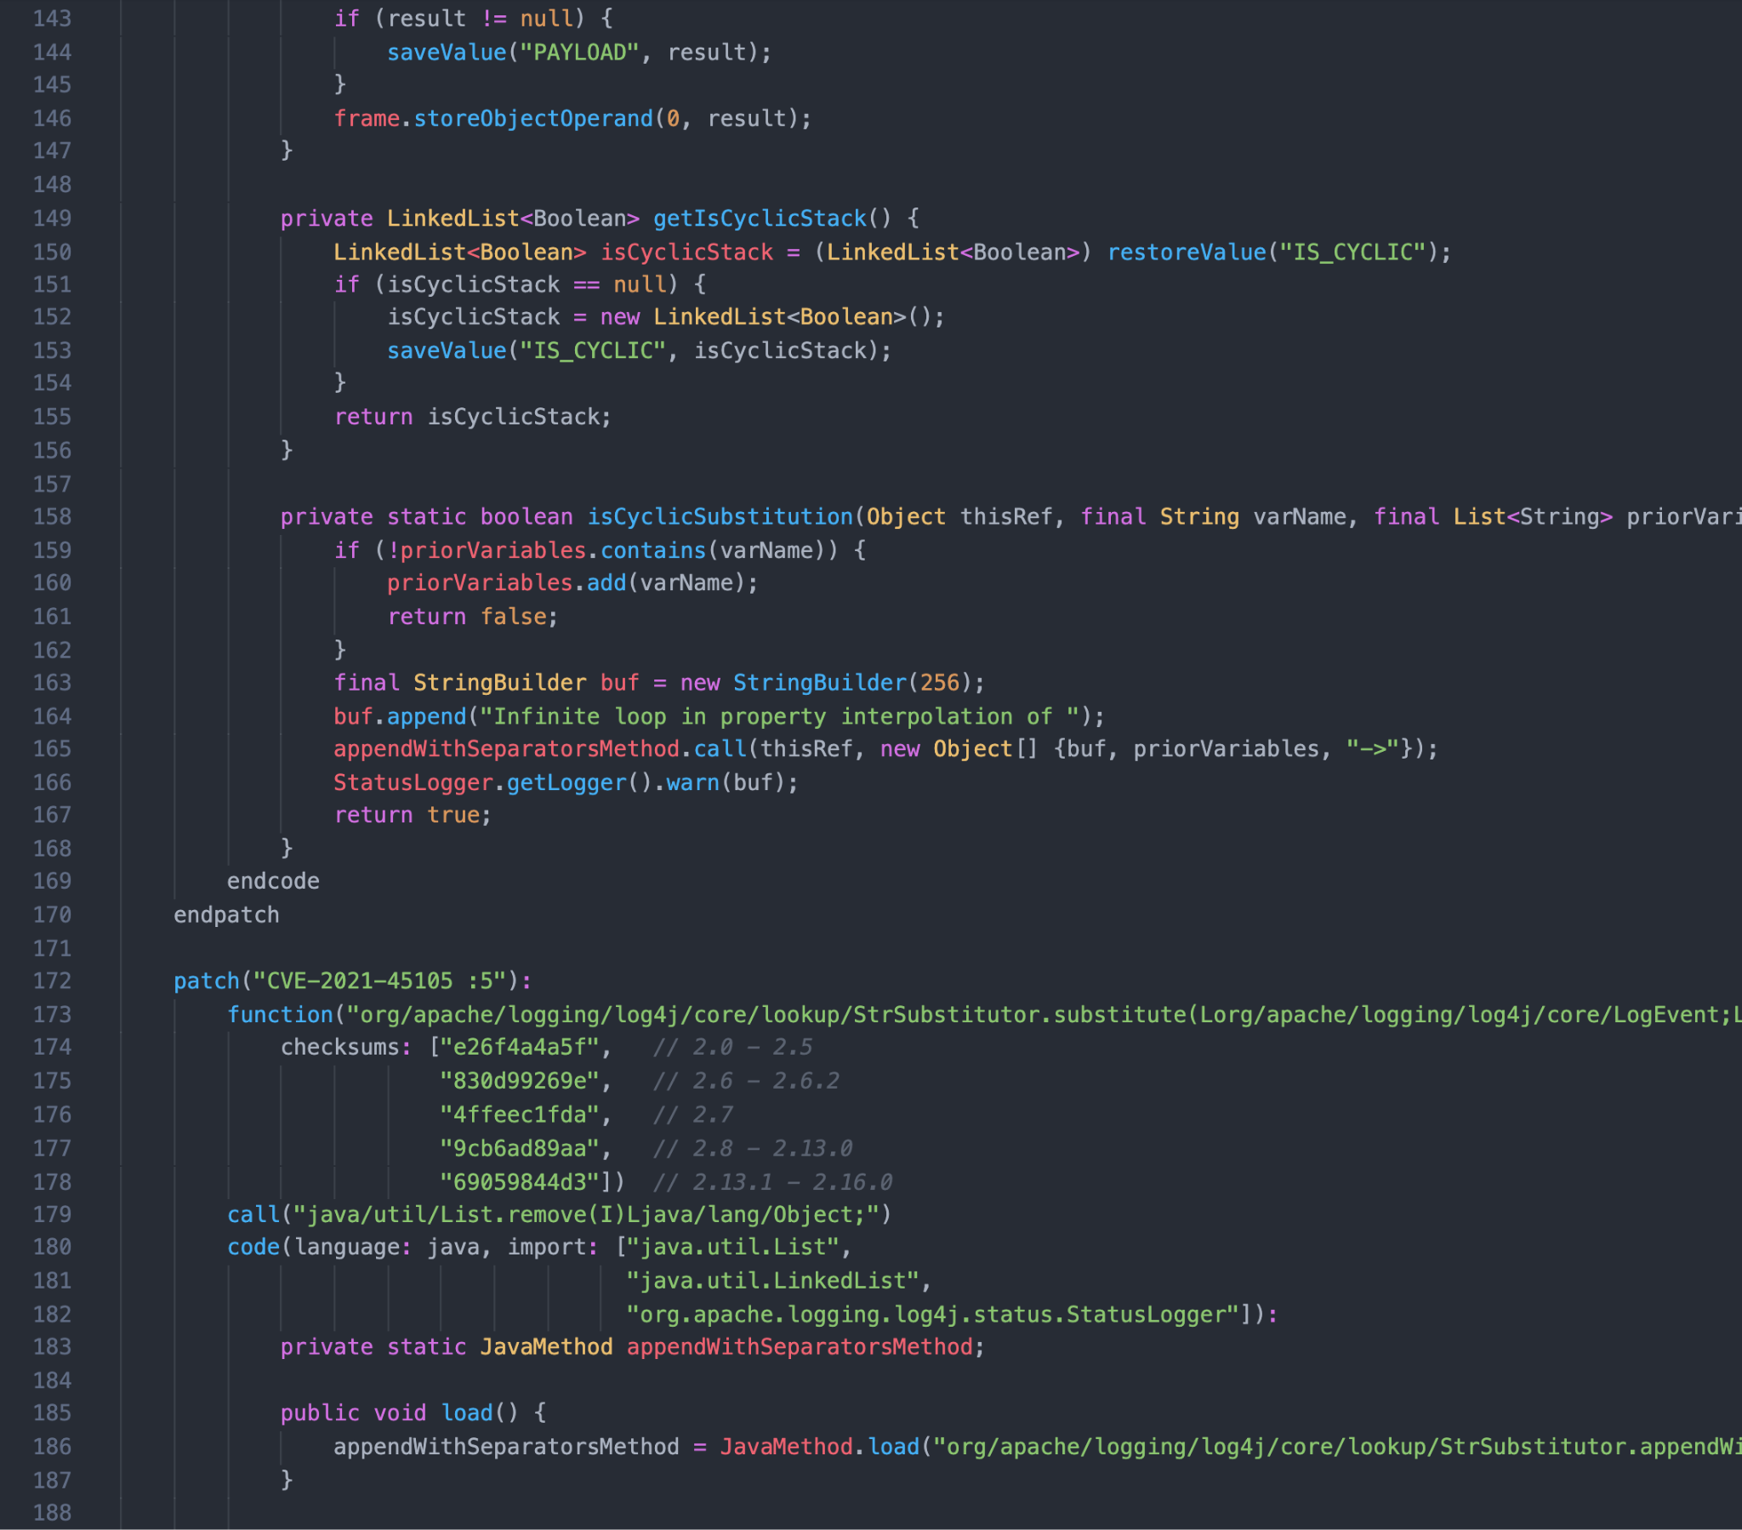
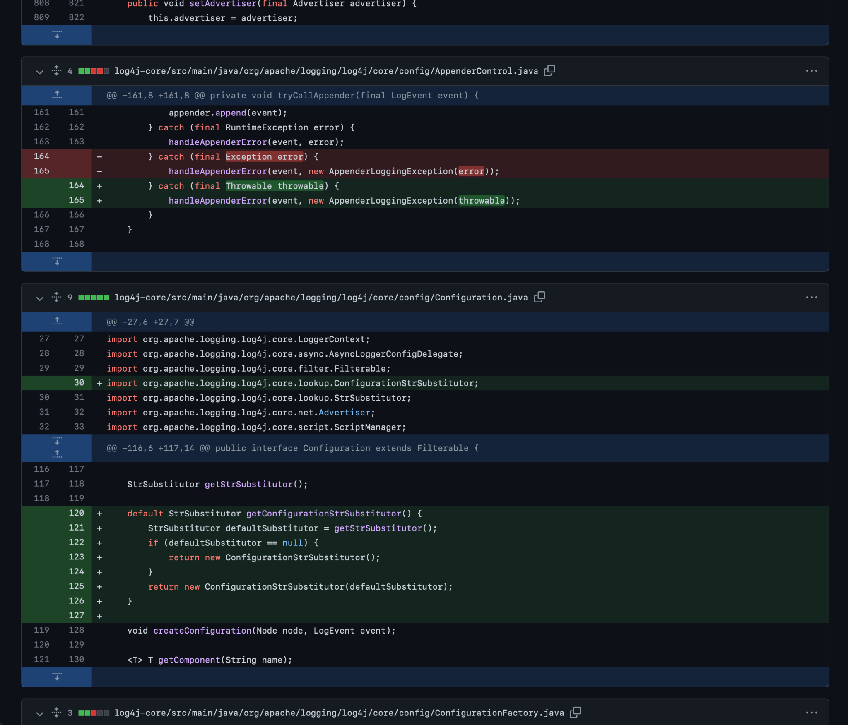
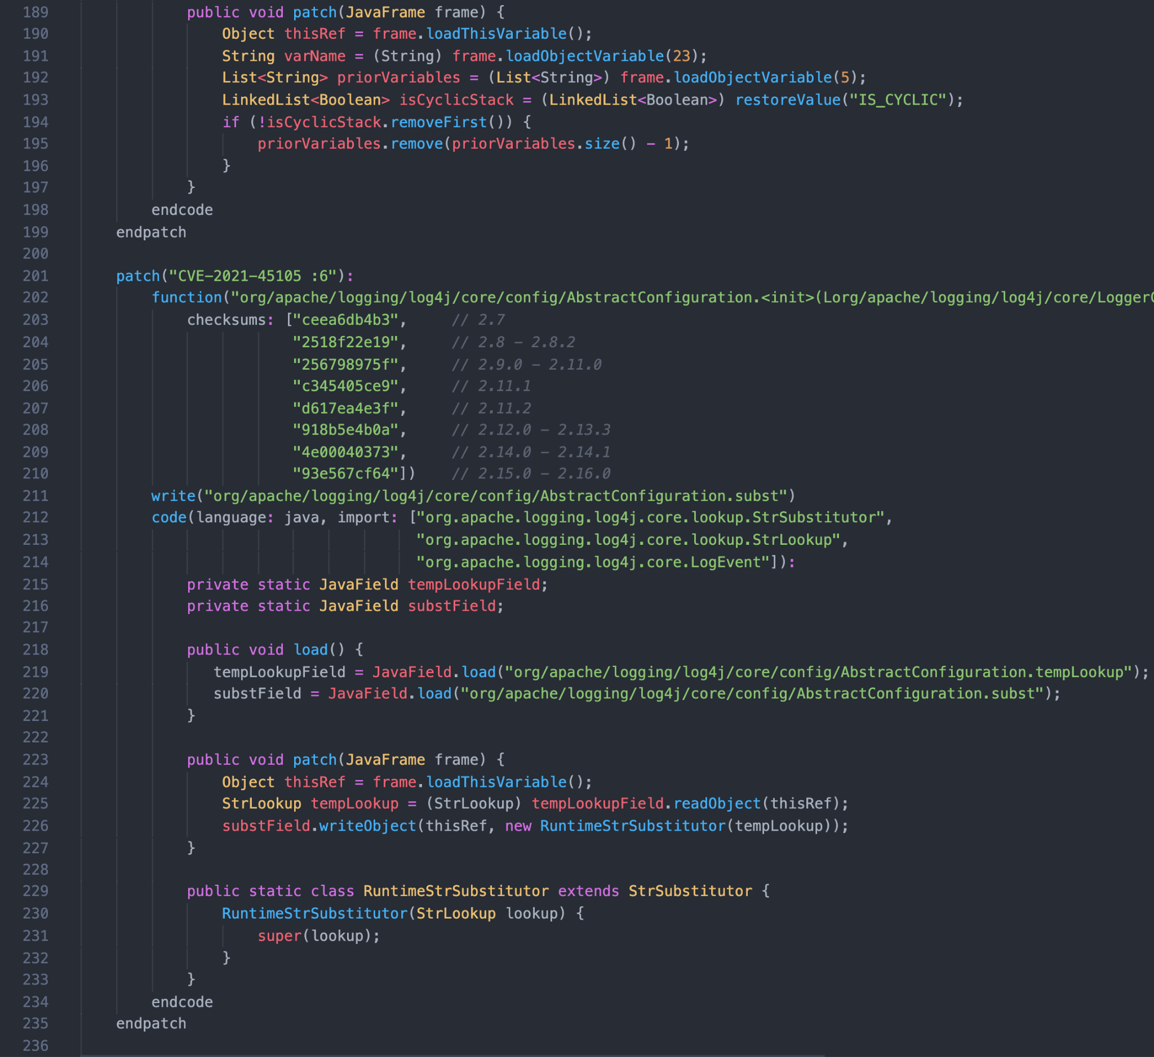
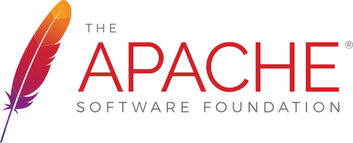
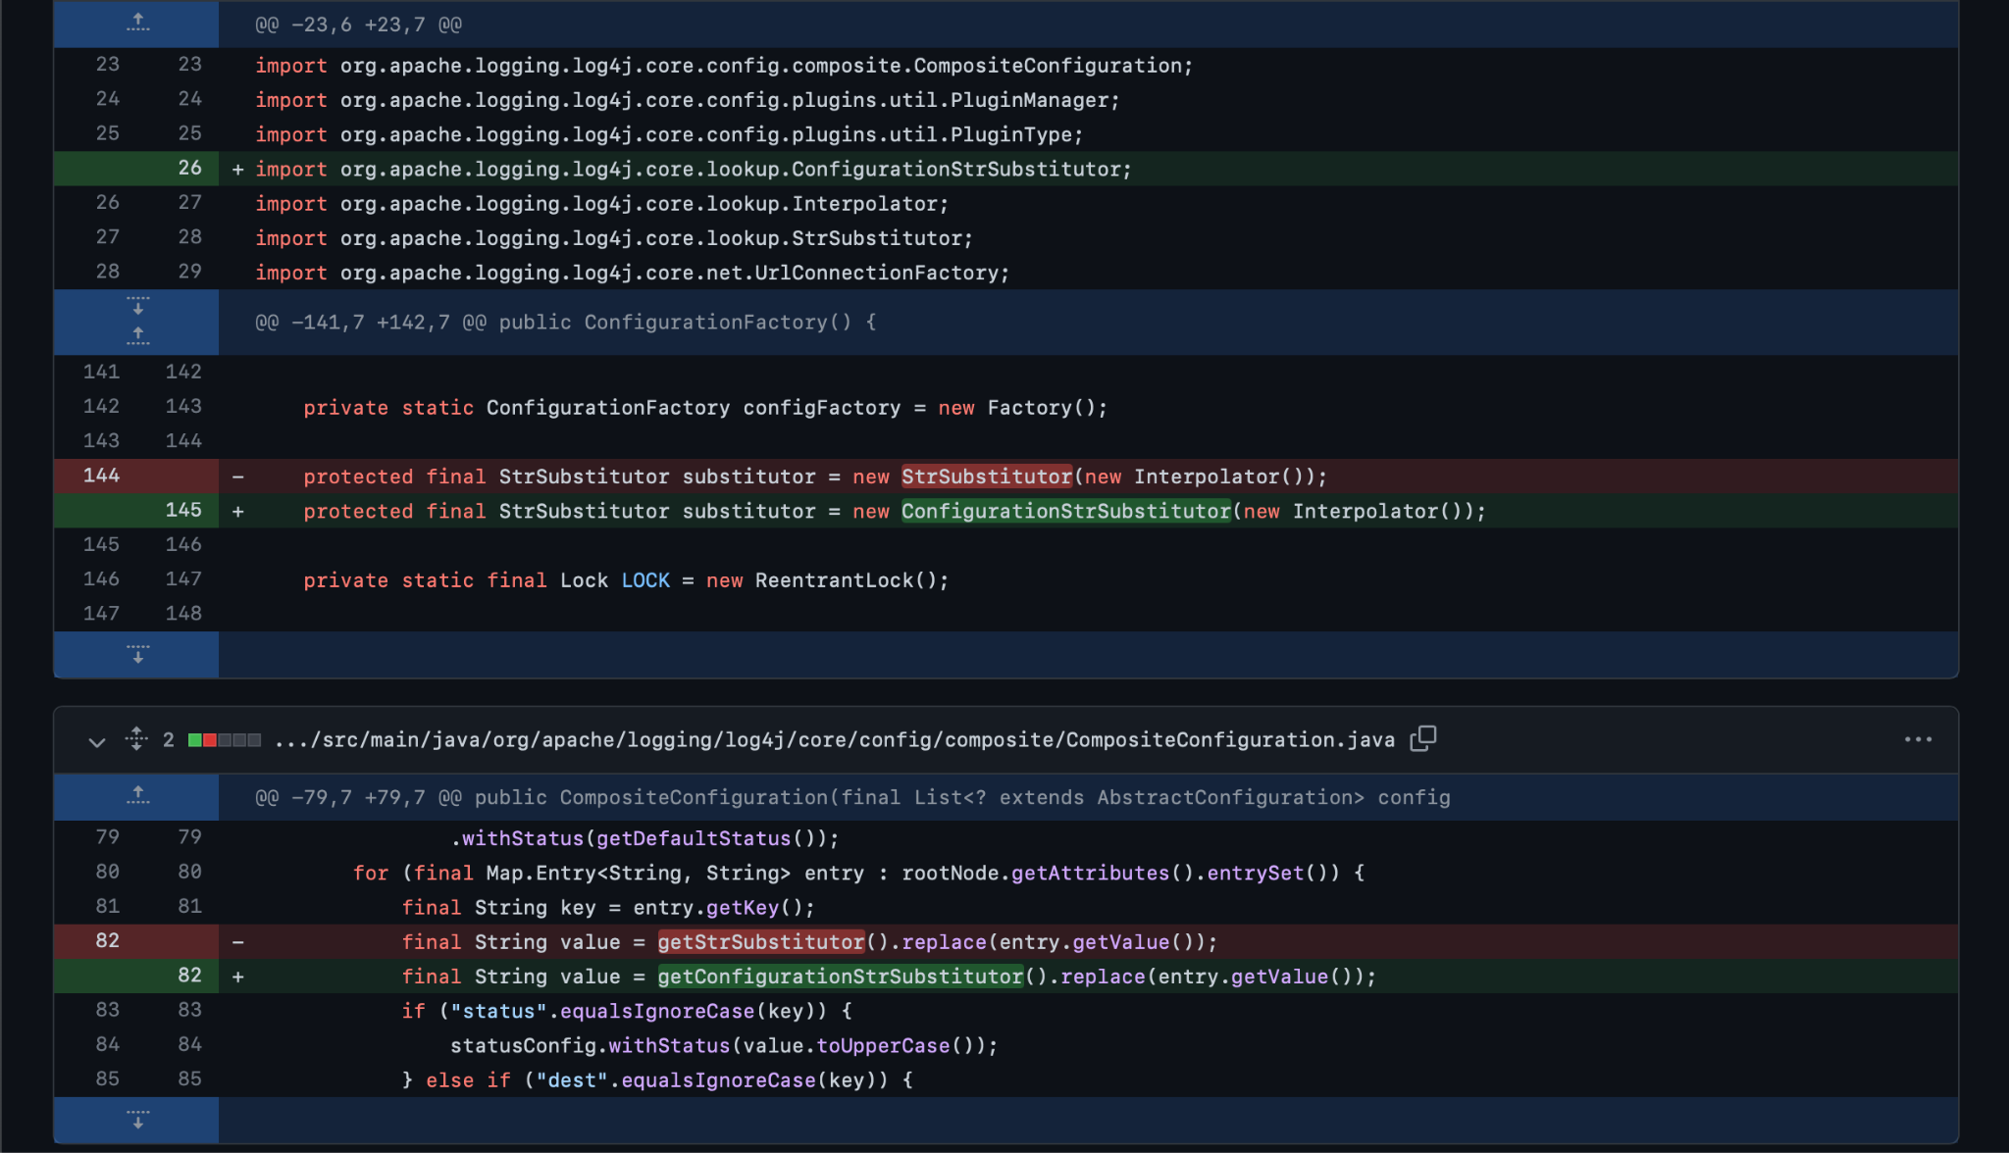

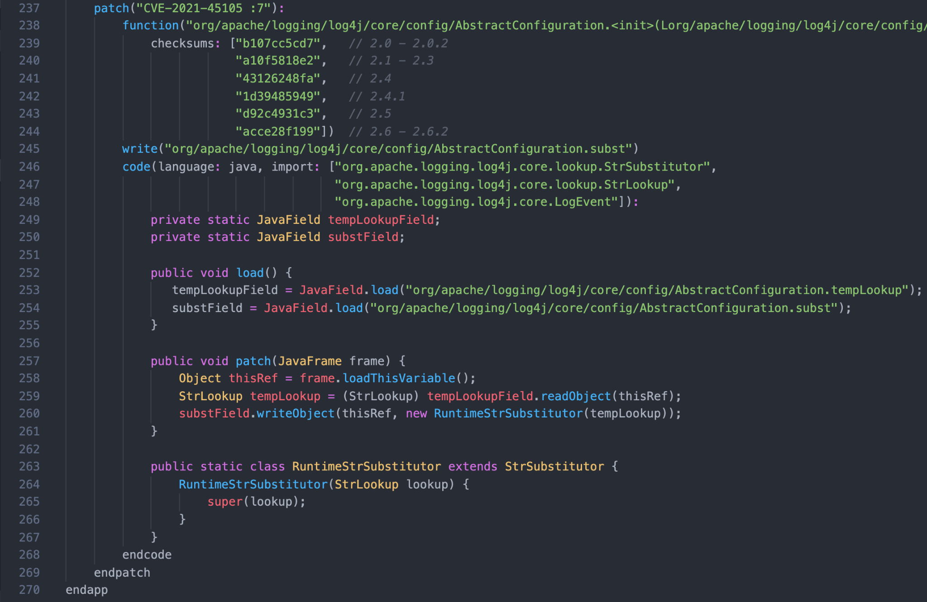
Imperative Rules
Vendor Patch for Log4j (CVE-2021-45105)
Equivalent Security-as-Code rule
Notes:
Next let’s look at… imperative.
Imperative is us telling the system what this vulnerability actually is.
Imagine being able to pinpoint Log4j vulnerabilities across tens of thousands of applications.
Now imagine being able to remediate those vulnerabilities in minutes without redeploying or downtime to those applications.
It’s hard, because you have to apply the patches, verify they didn’t break your application, and that’s one at a time, right?
Our imperative rule or virtual patch teaches the platform to detect, prevent and remediate vulnerabilities.
After the December 2021 Log4j exploit was released, a potential customer came to us questioning their third-party vendor’s statement that the Log4j risk no longer existed in that application. Three minutes after installing Waratek, we discovered the Log4j vulnerability still existed, and we mitigated the risk.
<ANY QUESTIONS?>

Slide 10

Instant Value, Protection and Certainty
One-Click Protection
Immediate risk remediation, operational cost savings (ROI), FTE not required
No Performance Impact
No reboots, no code changes or downtime
Eliminate False Positives
Focus on real threats, regain wasted operational time chasing ghosts

Slide 11
Demo
Notes:
Before we jump into the demo, is there anything specific that you want to ask or have clarified?

Slide 12








Who Owns Risk vs Who Fixes the Problem
Shared Ownership
Bridge to Customer Satisfaction
Lead Time
MTTR
Rollbacks
Security:
Own risk, but not fix
Engineering:
Own fix, but not risk
Customer Satisfaction
MTTD
Features
Failure Rate
Uptime
Copyright © 2024 Waratek | All Rights Reserved | Confidential
Notes:
Time, money, cross-functional goodwill. Java security is expensive.
It takes 19 days to weaponize a vulnerability, but 31 to patch it.
For example - Log4J. The vulnerability was published in 2013 but the exploit didn’t start to appear until early December 2021. In a matter of weeks, it was headlining news on the BBC and CNN. Our studies show that upwards of 70% of organizations are still not fully patched for log4j.
Emerging Java vulnerabilities increase 20% YoY, and security teams must rely on engineering teams that don’t have KPIs on security to patch them.
Security owns the risk but not the fix and this massive cost of protecting your Java applications results in a limited ability to secure them all.
Sure you can secure your most crucial applications, but that still leaves you open to supply chain attacks from your unsecured applications that are connected to the crucial ones.
Title: high friction costs money and time, hurting your ability to protect total app real estate

Slide 13
A story about our favorite semiconductor company
Zero
Code changes or restarts
Protection is applied in the runtime, fixing bytecode as it's executed.
2,500 apps
Remediated of Log4shell
Waratek deploys at scale with no tuning for out-of-the-box impact.
4 hours
To fully scale remediation
Waratek rules are extremely precise and actually fix the vulnerable code
Copyright © 2024 Waratek | All Rights Reserved | Confidential
Notes:
When one of the world’s top 25 technology companies expressed Log4j vulnerability concerns, their estimates to resolve the issues were in the hundreds of hours. Traditional vendor patches failed to fully mitigate these threats since some third-party libraries hadn’t updated yet, and applying patches required regression testing and system downtime, leaving systems exposed to hackers.
Fast-forward 4 hours, and 2,500 of their applications were fully remediated of Log4j vulnerabilities without code changes or application redeployments.
{first name}, have you encountered Log4j vulnerabilities? How many systems were affected?
[PAUSE - wait 10 seconds]

