Slide 1
Onboarding with Waratek
Support Briefing
Q4 2024
Copyright © 2024 Waratek | All Rights Reserved | Confidential

Slide 2
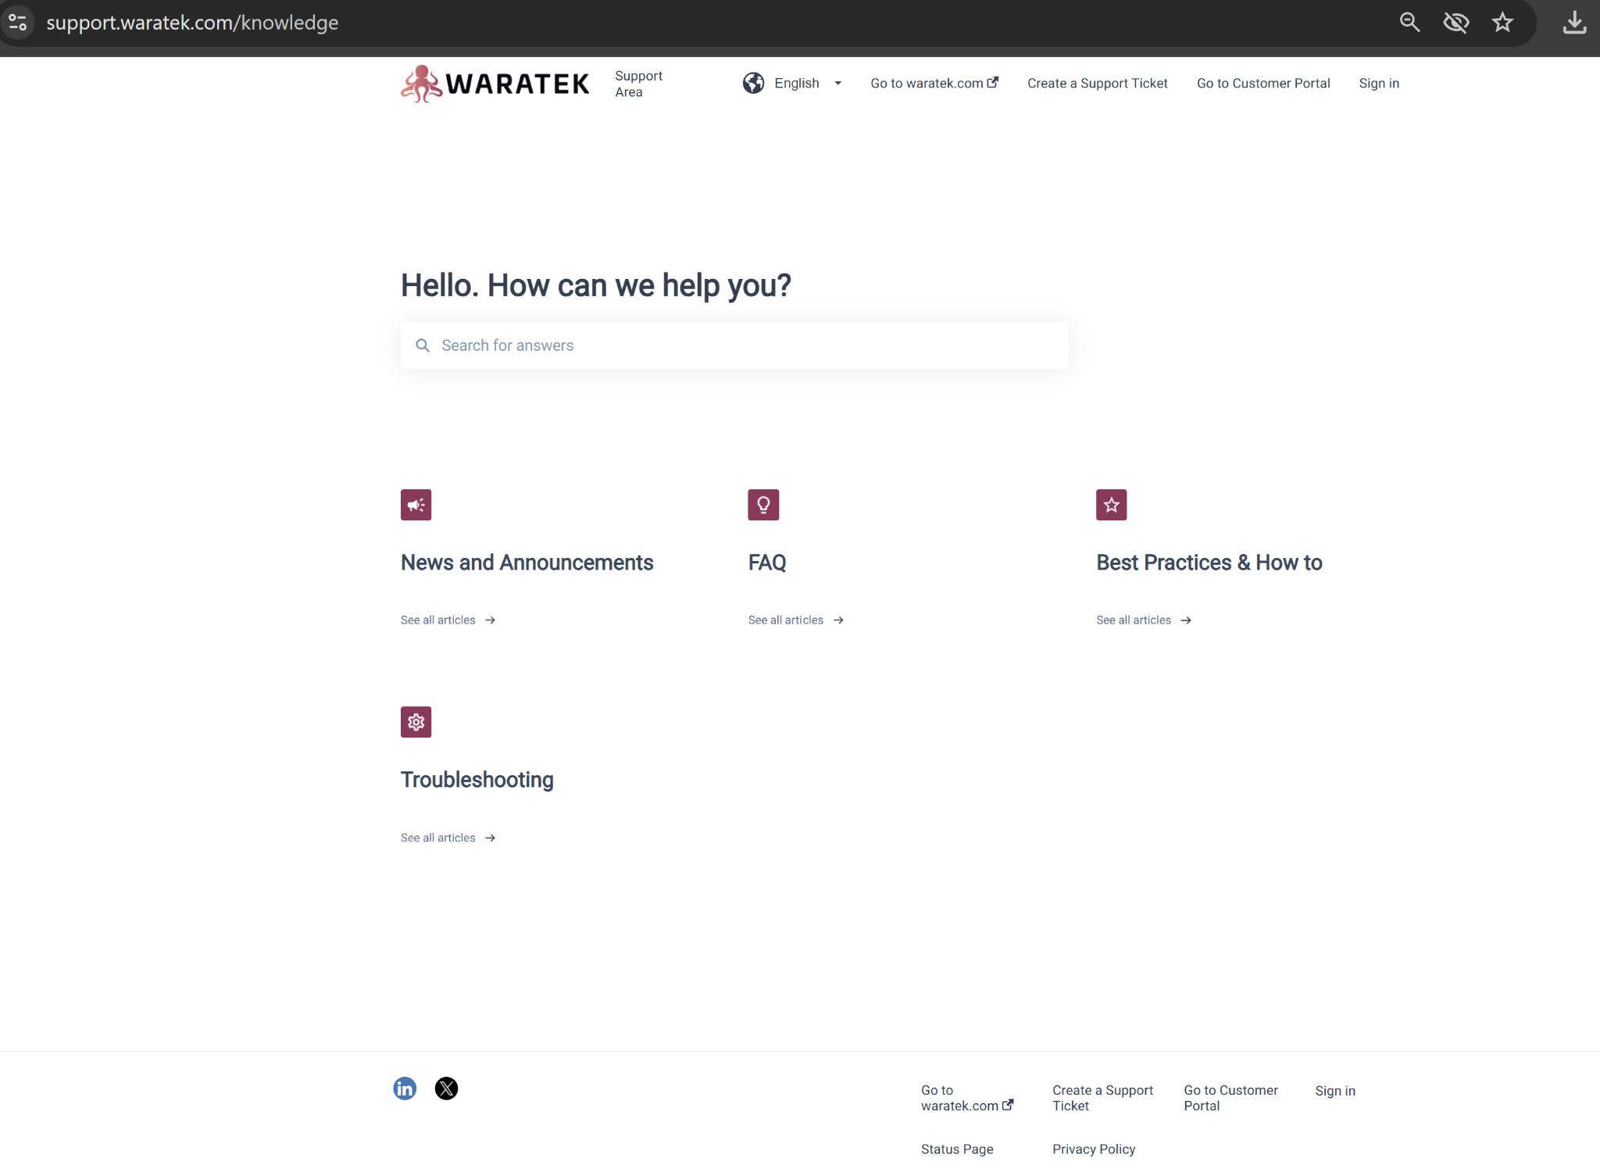
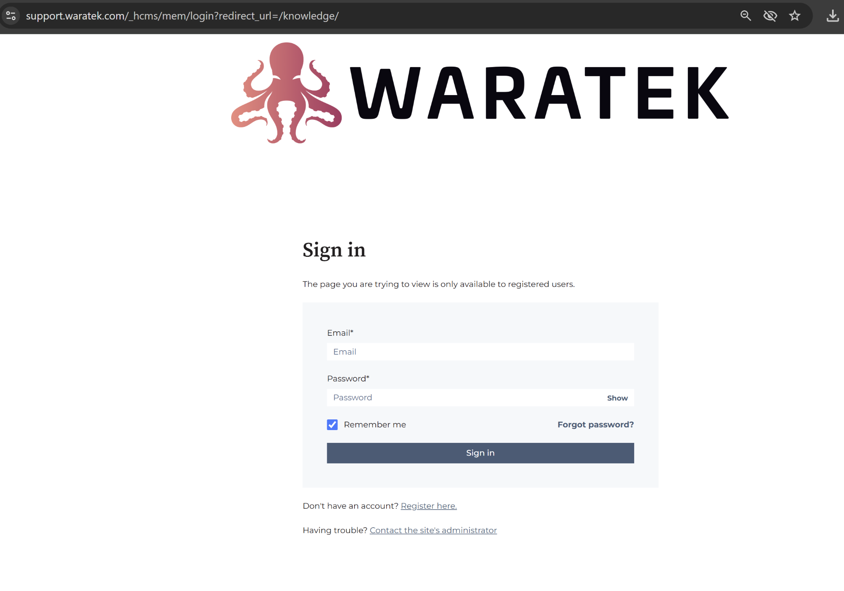
Customer Support Portal
Registration
WITH YOU ON YOUR JOURNEY TO PRODUCTION

Slide 3
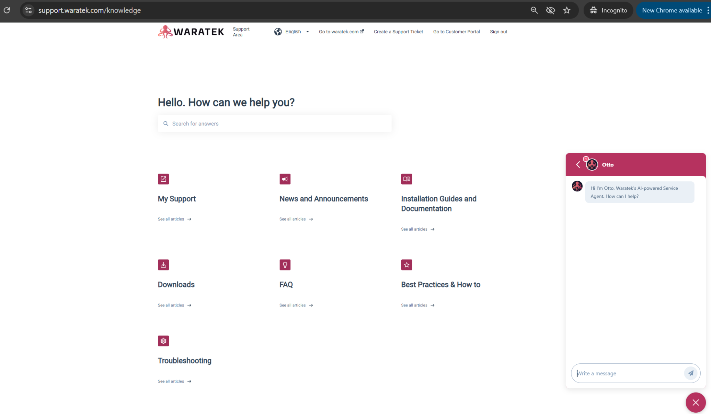
Customer Support Portal
Registration Post Validation by Waratek - Full Access to Knowledge Base
WITH YOU ON YOUR JOURNEY TO PRODUCTION

Slide 4
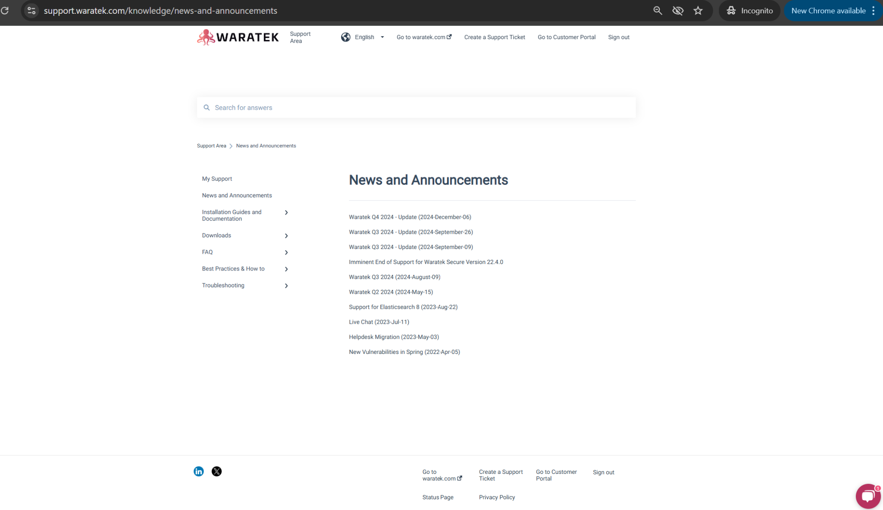
Customer Support Portal
Knowledge Base Categories - News and Announcements
WITH YOU ON YOUR JOURNEY TO PRODUCTION

Slide 5
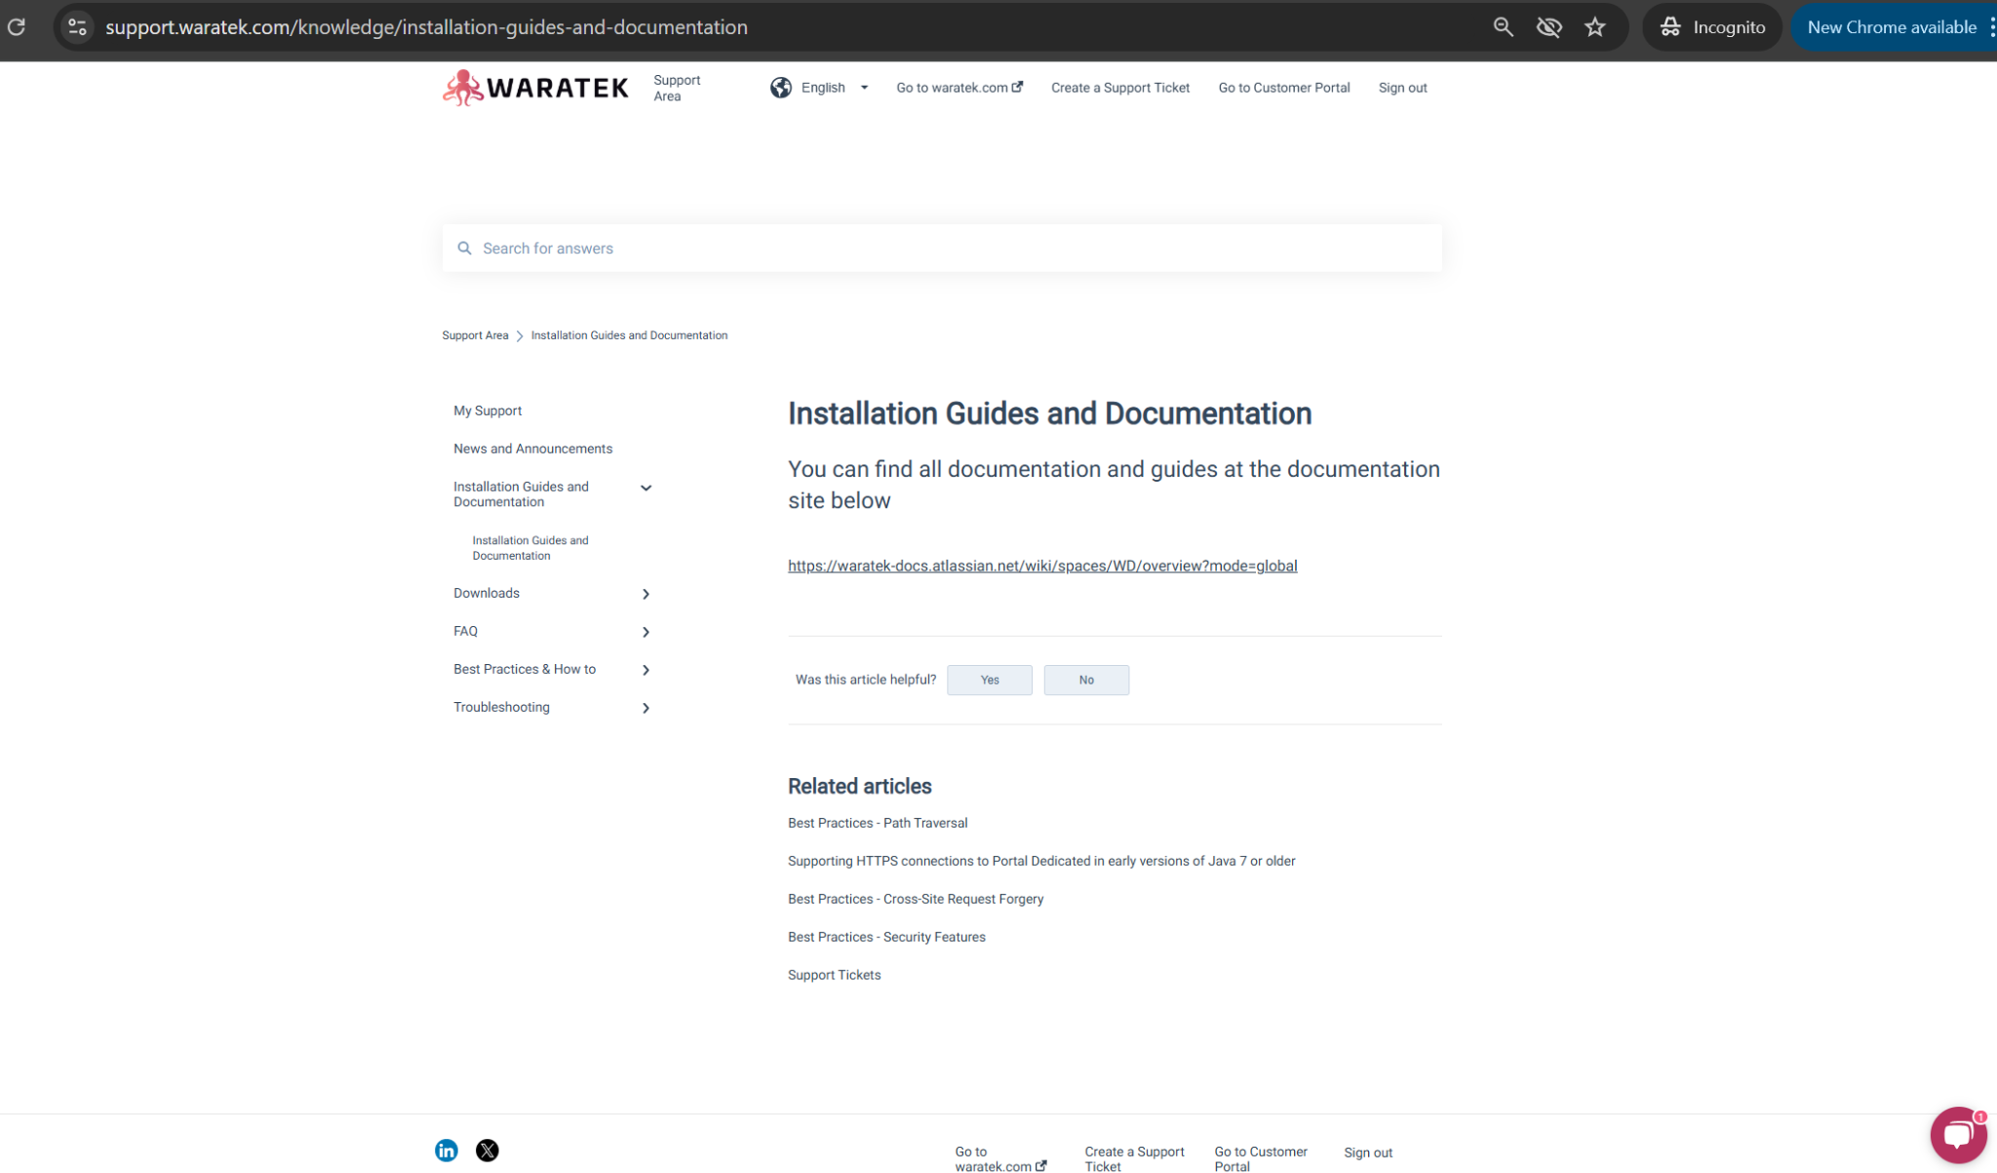
Customer Support Portal
Knowledge Base Categories - Installation Guides and Documentation
Docs will soon be directly available on the Customer Portal and full searchable
WITH YOU ON YOUR JOURNEY TO PRODUCTION

Slide 6
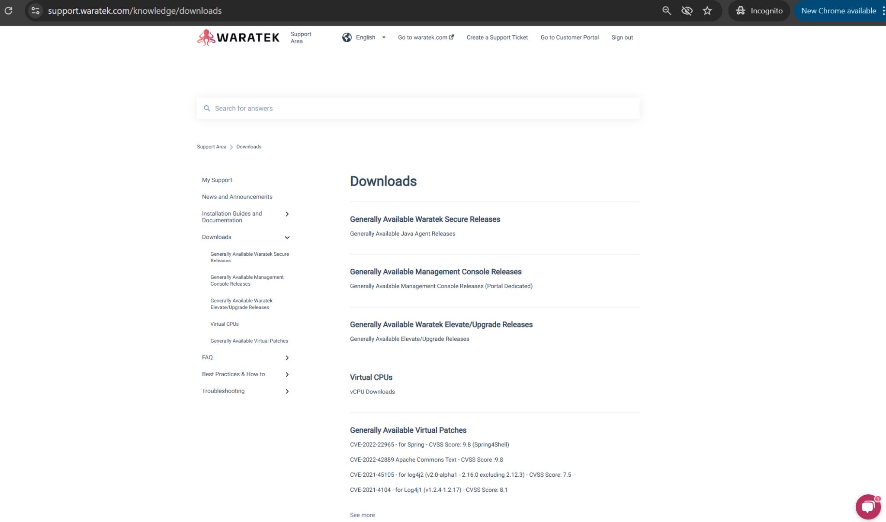
Customer Support Portal
Knowledge Base Categories - Downloads
WITH YOU ON YOUR JOURNEY TO PRODUCTION

Slide 7
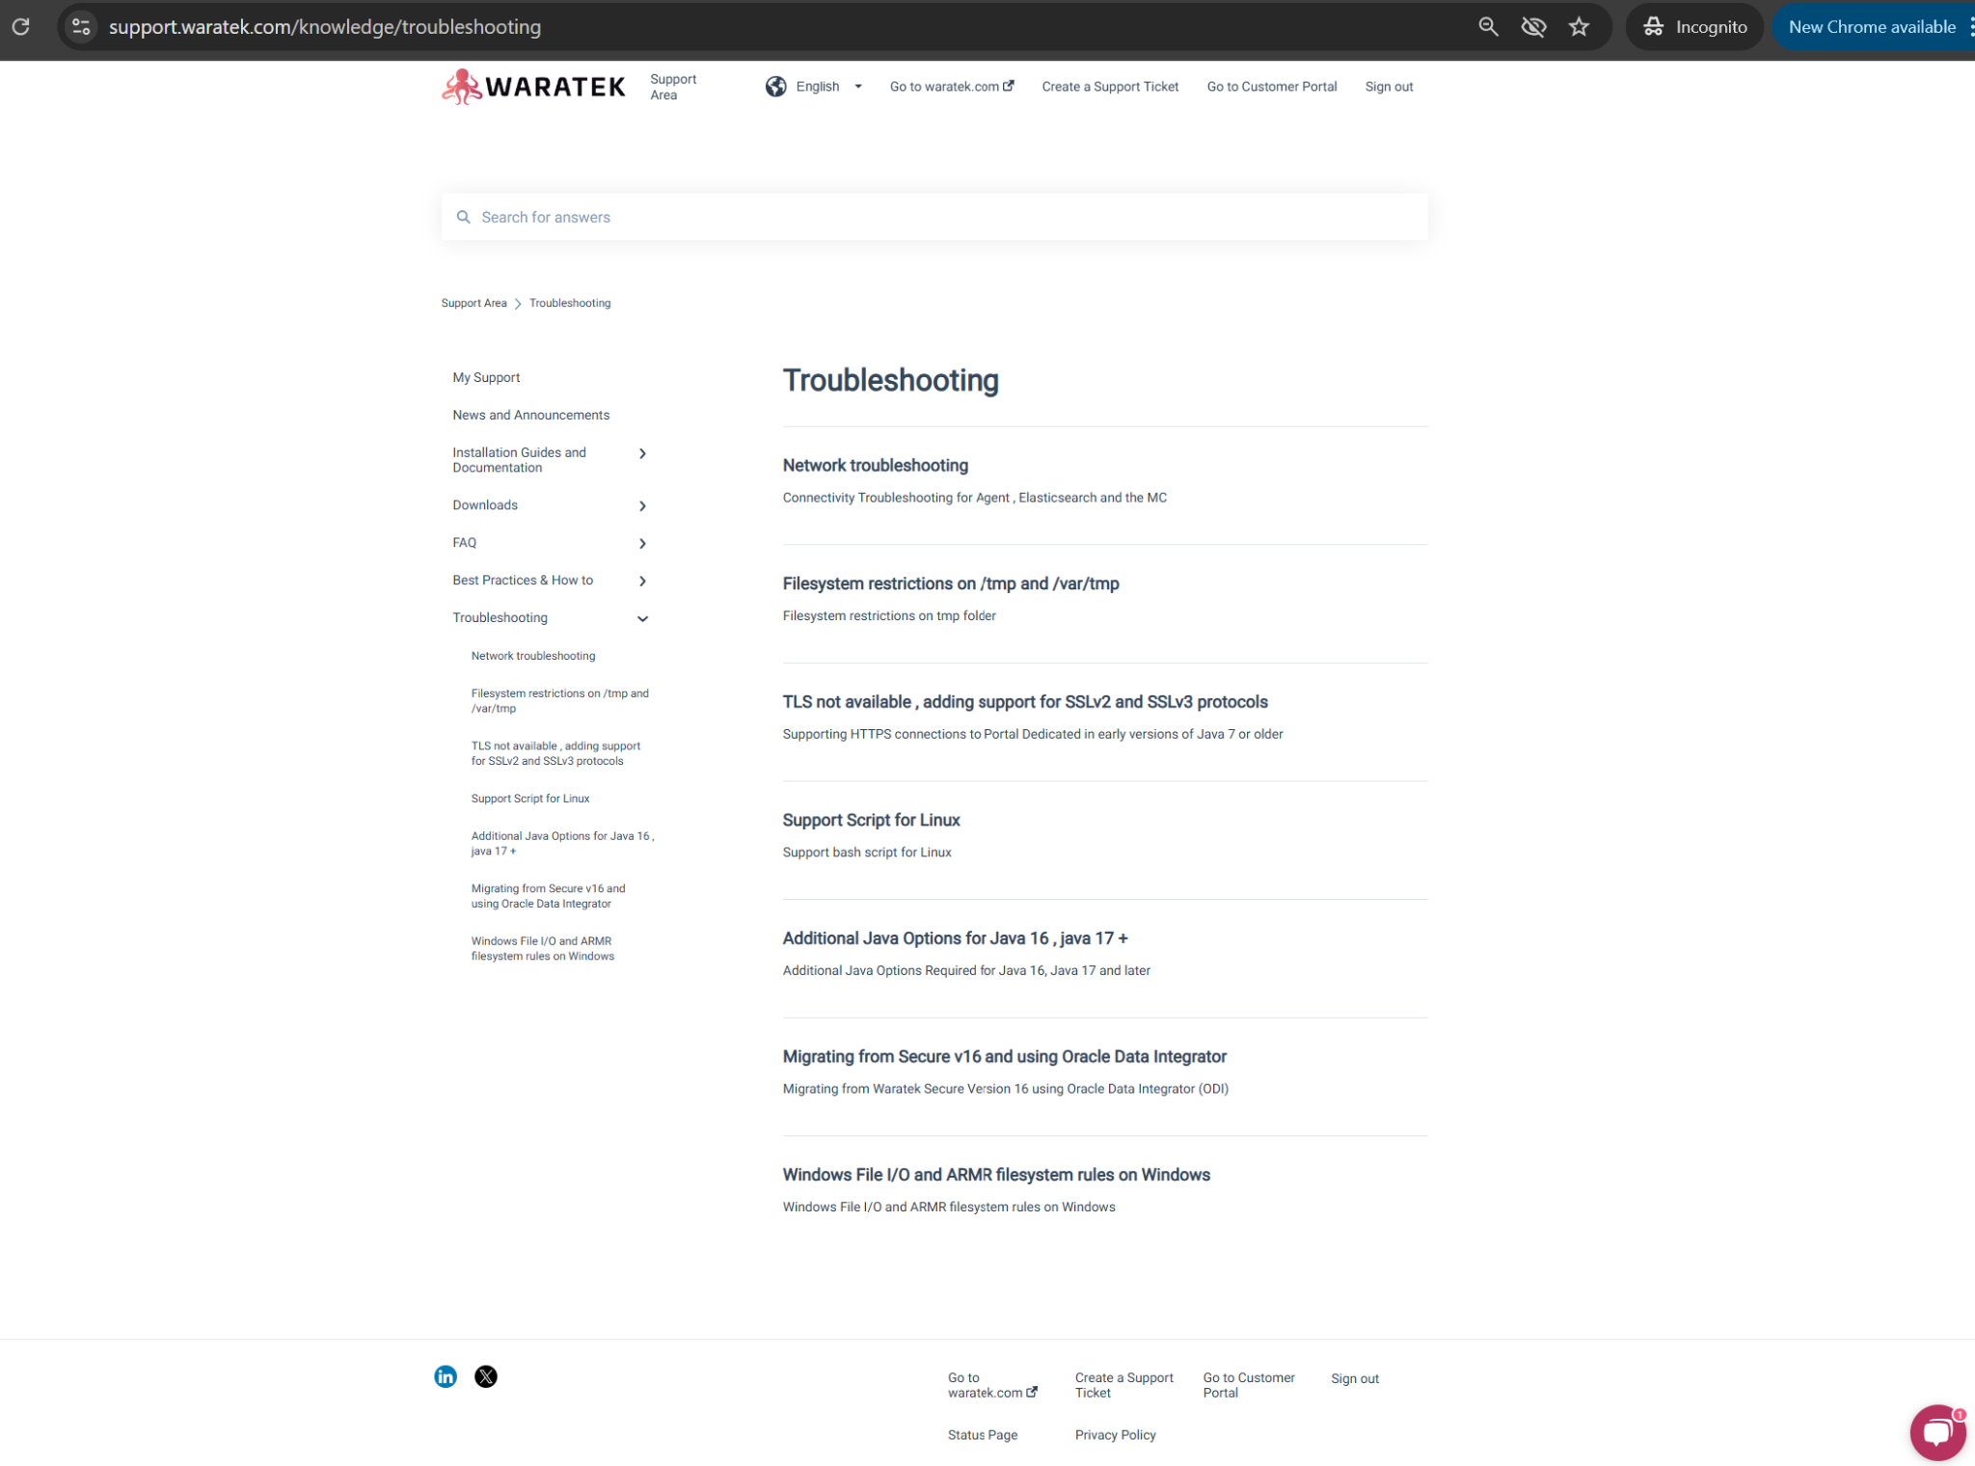
Customer Support Portal
Knowledge Base Categories - Troubleshooting
WITH YOU ON YOUR JOURNEY TO PRODUCTION

Slide 8
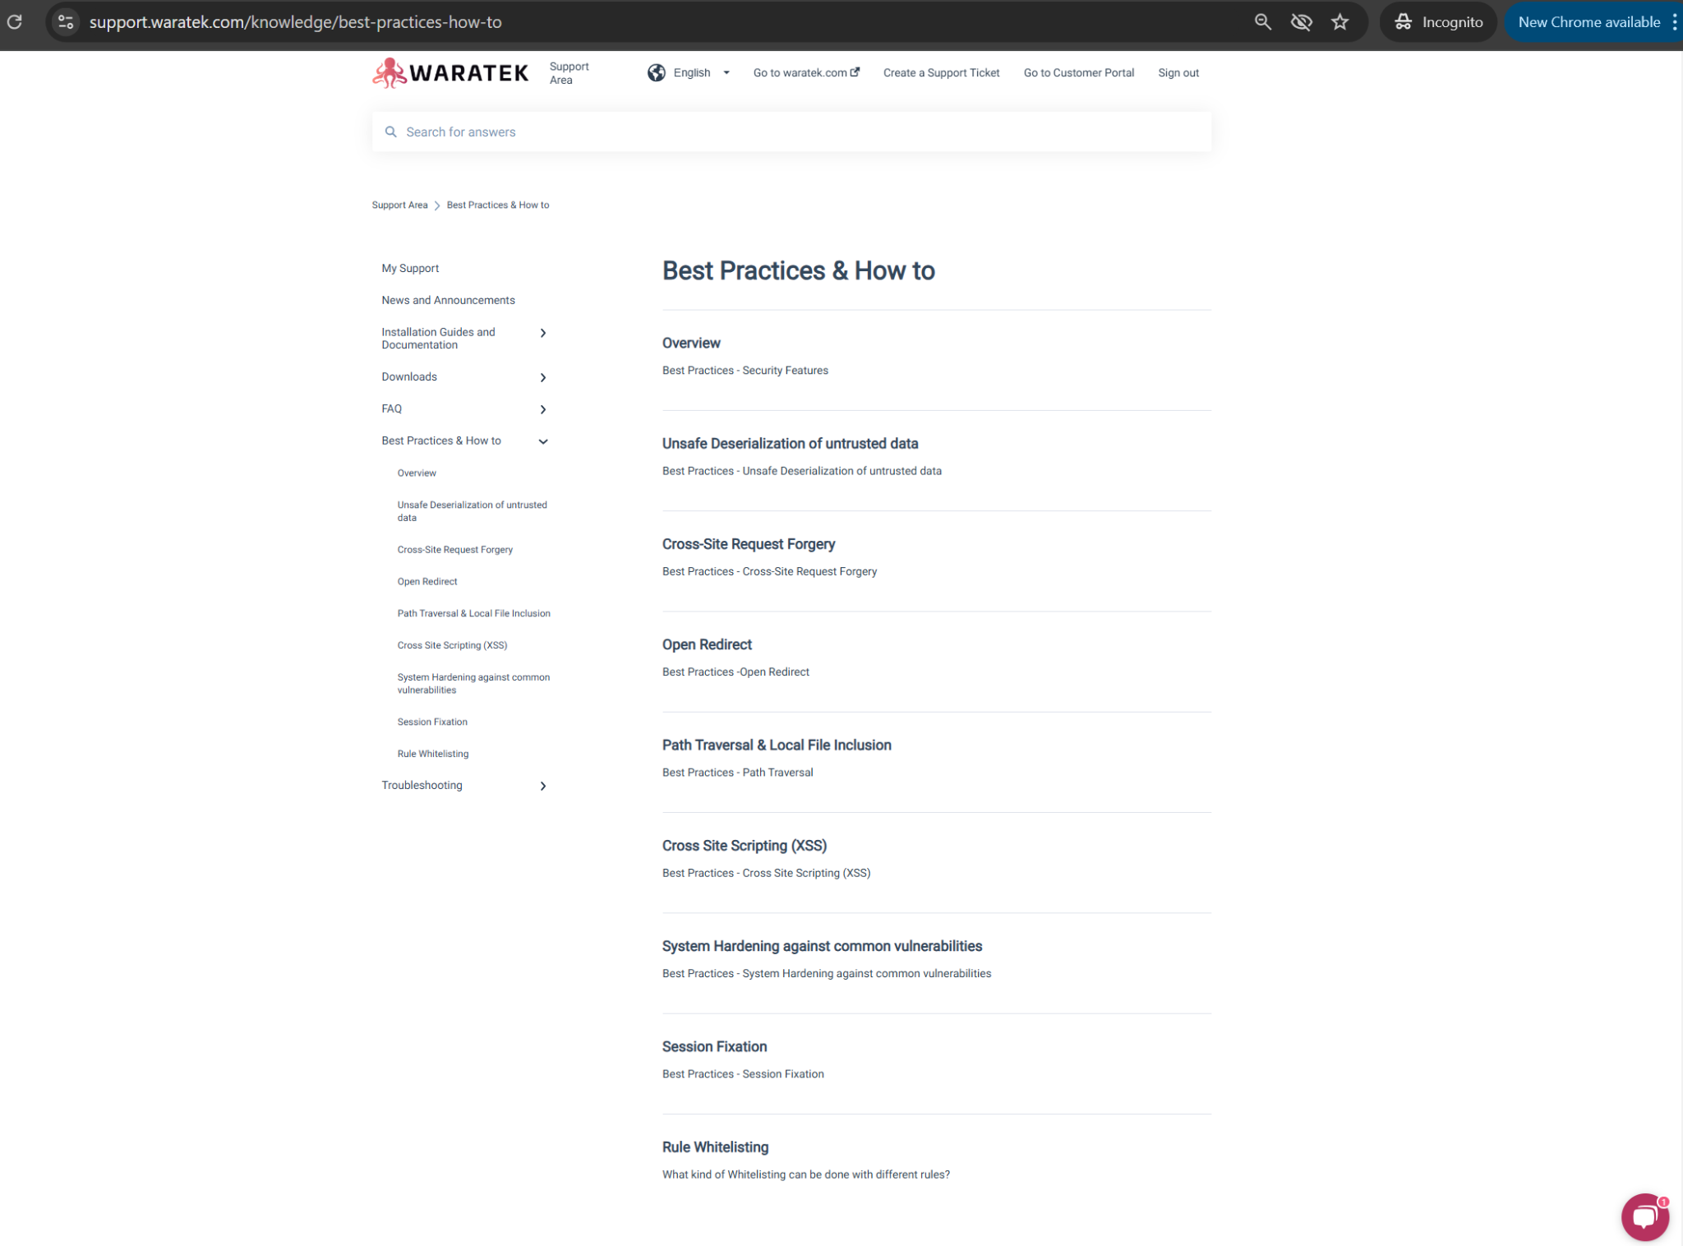
Customer Support Portal
Knowledge Base Categories - Best Practices
WITH YOU ON YOUR JOURNEY TO PRODUCTION

Slide 9
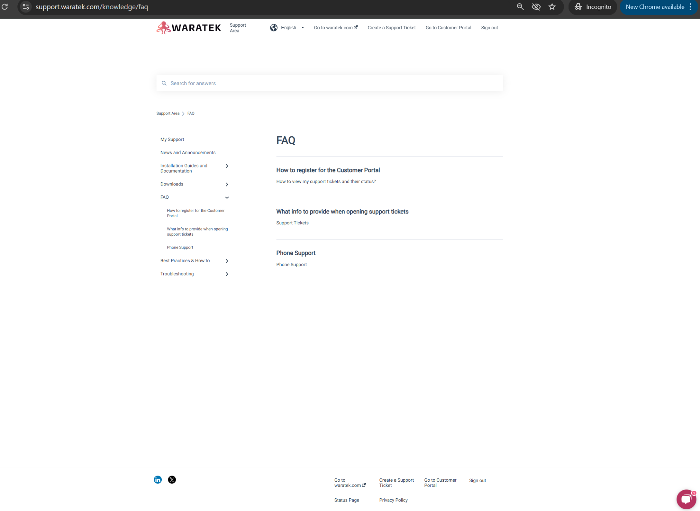
Customer Support Portal
Knowledge Base Categories - FAQ & My Support
WIP…ideas, suggestions and proposals for additions and improvements are most welcome, in all categories, especially these!
WITH YOU ON YOUR JOURNEY TO PRODUCTION

